Slide 1
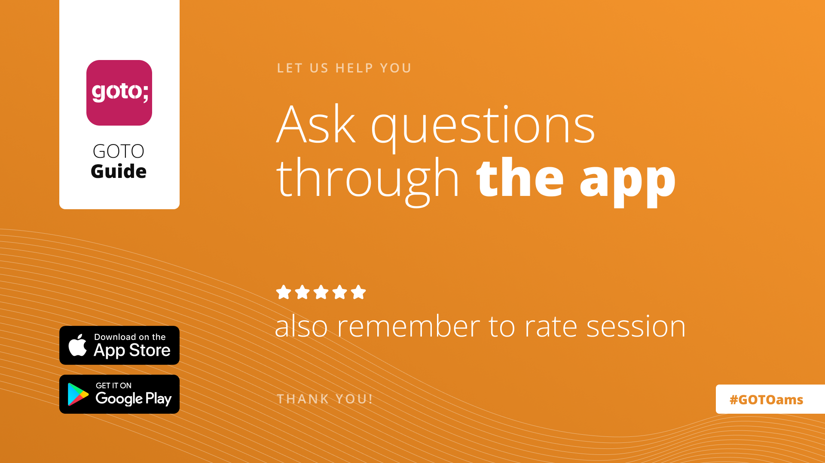

Slide 2
Loosely Coupled Lotteries and Cloudy Casinos
A case study of the
Nederlandse Loterij Integration Platform

Slide 3


About Me
Joris Kuipers
@jkuipers
CTO, hands-on architect and
fly-by-night Spring trainer
@ Trifork Amsterdam

Slide 4

Introduction
Integration platform for Nederlandse Loterij
Expose many backends to clients by providing
APIs based on custom domain model
  Encapsulate backend details
  Facilitate future replacement
Serves ca. 2 million users
  peaks during state lottery draws and big soccer games

Slide 5

Project Milestones
Lottery migration completed with Staatsloterij early 2021
  Including custom subscription system!
Since October, new law “Kansspelen Op Afstand” in effect
  Allowing online casino and live sportsbetting
  Strict regulations around addiction and fraud prevention
  Requiring many new systems to be integrated
  (current count around 30)

Slide 6
Microservices: Rationale & Setup
“And all these years before, well, I was blind
That's my conclusion
'Cause I'm the architect”
― dEUS, The Architect

Slide 7

Microservices: Common Reasons
Limit inter-team
coordination/communication
  We are one team
Different tech stacks
  All services built with Spring Boot
Different life cycles
  Regular release deploys everything together

Slide 8

Our Reasons?
It was all the rage when we started
Resumé-driven development
I want to talk at conferences
Thanks for coming to my talk…

Slide 9
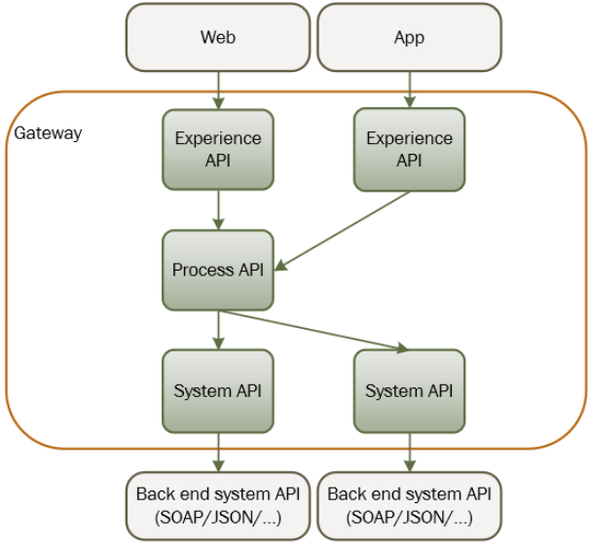
Architecture
Separate domains
(verticals)
and service types
(horizontals)
Verticals:
specific games,
subscriptions, players, …
Notes:
Expected end result around 30 services

Slide 10

Microservices: Our Reasons
During Development:
Only run what’s relevant locally
  No need to run whole platform
Only know what’s relevant
  Ignore parts you don’t know / care about
Experience per client nice granularity
  Security, focused API, compatibility over time

Slide 11
Microservices: Our Reasons
At Runtime:
Per-service scalability
  E.g. for Staatsloterij draw or big soccer match
Limit blast radius when service fails
  Very important for availability
Easier to update ad-hoc
  Just push image &
  update Kubernetes deployment

Slide 12

Resulting Project Setup
Every service is Spring Boot app
  On Kubernetes (AWS EKS)
HTTP and messaging for inter-service communication
Mono-repo using Gradle build
  30+ services, deployed together
  Various shared libraries
  Builds usually take < 5 minutes

Slide 13
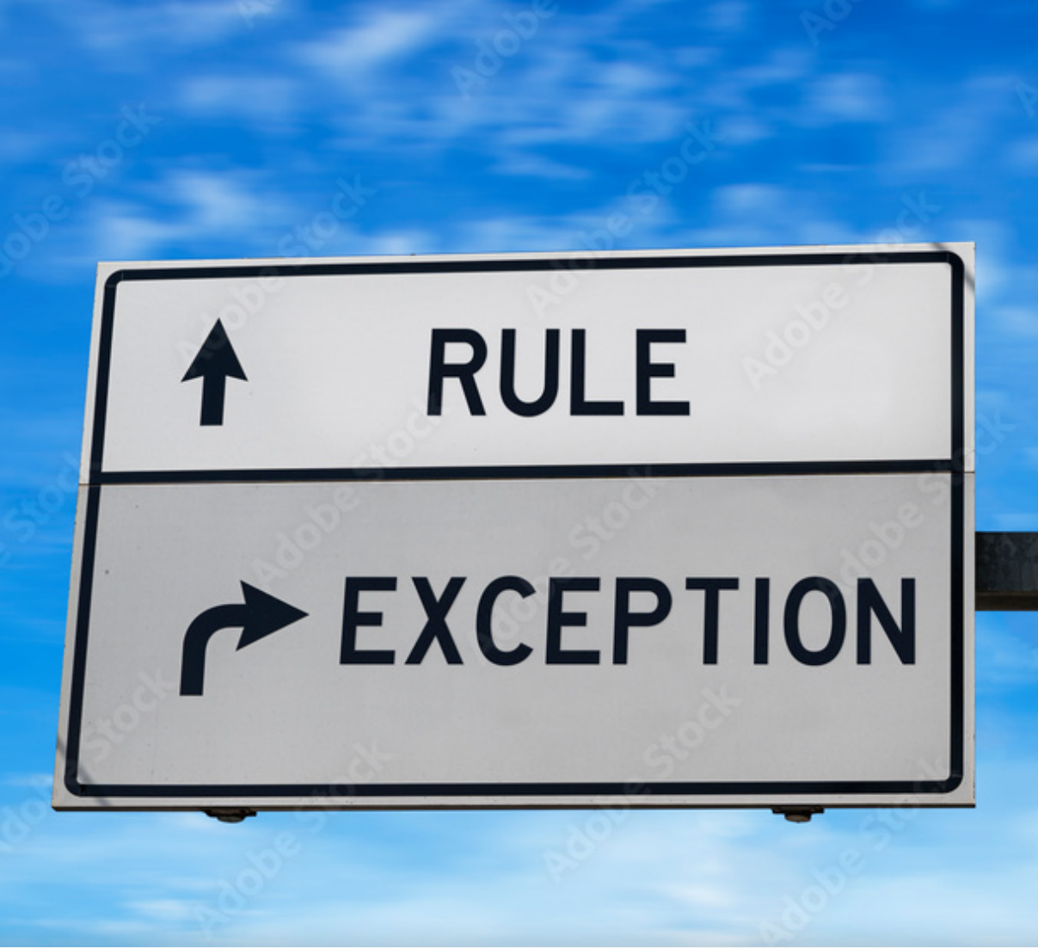
Architecture In Practice
Some verticals follow architecture shown
  i.e. experience + process + system service
  Some processes have multiple experiences:
  explicit goal!
But not all
Let’s look at exceptions

Slide 14

System Services (Adapters)
Dedicated System service can be overkill
Use when dealing with:
  Big, important backend system w/ central role
  Client is just a message listener
  Client requires “weird” tech
    Looking at you, Azure EventHub SDK!
Otherwise, call backends
directly from process service

Slide 15
All-In-One Services
Experience-process separation not always useful
In that case, simply provide all-in-one service
  Log-in service to retrieve bearer token for clients
  Financial services for retailer invoicing and
  general ledger bookings
Still allows for extracting process service later

Slide 16

Resulting Coupling
Basically end up with “clusters” of services
  Some tightly coupled, by design
  Some more loosely coupled
  Some completely independant of others
Very happy with results
  Operating platform for 4+ years now
  Still expanding

Slide 17
Observability
“To acquire knowledge, one must study;
but to acquire wisdom, one must observe.”
― Marilyn vos Savant

Slide 18
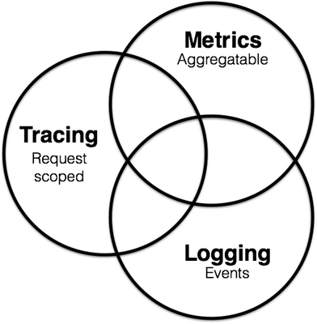
The Three Pillars Of Observability

Slide 19
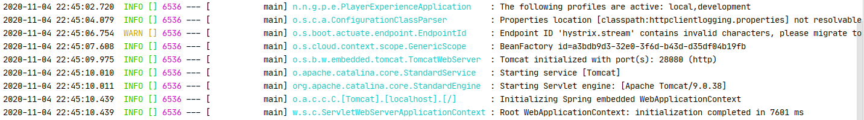
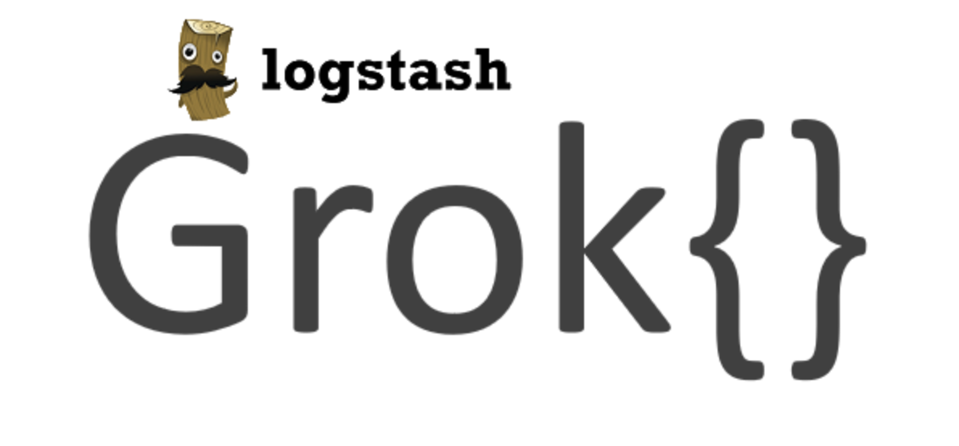
Patterns vs Structured Logging
Logging output often follows pattern
Problematic
  Lossy, hard to parse, multiline messages

Slide 20
Patterns vs Structured Logging
Structured logs don’t have these problems
Typically use JSON
  Supported by many aggregators as-is
Easy to add additional fields
{"@timestamp":"2020-11-16T09:34:25.118+01:00",
"message":"Starting service [Tomcat]",
"logger.name":"org.apache.catalina.core.StandardService",
"logger.thread_name":"main","level":"INFO",
"service":"player-experience","region":"eu-west-1"}

Slide 21
Logging Appender Configuration
<included>
<springProperty name="service"
source="spring.application.name/>
<appender name="CONSOLE_JSON"
class="ch.qos.logback.core.ConsoleAppender">
<encoder class="net.logstash.logback.encoder.LogstashEncoder">
<customFields>{"service":"${service}"}</customFields>
</encoder>
</appender>
…
</included>

Slide 22
MDC
Mapped Diagnostic Context:
key-value pairs associated with current thread
  Made available for logging
  Standard feature in most logging frameworks
Many use cases
  Current user, tenant, request URL, etc.
public class MdcPopulatingFilter extends OncePerRequestFilter {
protected void doFilterInternal(HttpServletRequest req, HttpServletResponse res,
FilterChain chain) throws ServletException, IOException {
try (var u = MDC.putCloseable("uri", req.getRequestURI())) {
chain.doFilter(req, res);
}
}

Slide 23
Traces and Slices
Trace ID generated once per incoming request,
propagated with downstream calls
  Included in all logging
  We include them as response headers as well
Every “hop” start a new slice within the trace
  Actual network hop, or logical within a service
  Traces can be exported to tracing DB

Slide 24
Demo Logging + Tracing
“Inlane” retrieval of winnings for a scratch ticket

Slide 25
Metrics
Pre-aggregated numeric info
  Counters, timers, gauge, distribution-summary, …
  Like mix, max, avg response times for MVC controllers
  Very different from individual log events
Enriched with tags or dimensions
  Like HTTP method, path, status code, …
Sent to time-series DB for storing
  For dashboarding and alerting
  Slicing & dicing based on tags

Slide 26
Metrics Benefits
Compared to logging:
Scales much better: bigger numbers, not more
Faster to work with for big periods of time
Cheaper to store
Provides lots of insight into both infra and busines without doing any work

Slide 27
Conclusion
Reasons for microservices vary wildly
  Understand what matters to you!
Ability to observe your services is crucial
  Don’t make this an afterthought
  Allow developers access to production!
Talk to me if you’re interested to learn more

Slide 28
