Slide 2
Are we really engineers?
Notes:
SLOWER

Slide 3
Is Software Development a Branch of Engineering?
Notes:
Yes: on our business cards

Slide 4
Why wouldn't Software Development be a Branch of Engineering?
Notes:
Yes: on our business cards

Slide 5




If builders built houses the way programmers built programs, the first woodpecker to come along would destroy civilization.
Gerald Weinberg

Slide 6

Software development is only like bridge building if you're building a bridge on the planet Jupiter, out of newly invented materials, using construction equipment that didn't exist five years ago.
Jeff Atwood
Notes:
https://discourse.codinghorror.com/t/bridges-software-engineering-and-god/1098/20
https://blog.codinghorror.com/bridges-software-engineering-and-god/
Logo image from https://blog.codinghorror.com/

Slide 7

theory Leftpad
imports Main
begin
(* What does it mean to be padded? A string can be split into two parts where the first part
is all padding and the second is the original string: *)
definition isPadded where "isPadded padChar unpadded padded
\<equiv> \<exists> n. set (take n padded) \<subseteq> { padChar } \<and> drop n padded = unpadded"
(* The star of the show is the `leftPad` function ... *)
definition leftPad where "leftPad padChar targetLength s
\<equiv> replicate (targetLength - length s) padChar @ s"
(* ... which satisfies the spec: *)
lemma isPadded_leftPad: "isPadded padChar s (leftPad padChar targetLength s)"
unfolding isPadded_def leftPad_def by (intro exI [where x = "targetLength - length s"], auto)
lemma length_leftPad: "length (leftPad padChar targetLength s) = max targetLength (length s)"
unfolding leftPad_def by auto
(* But, hold on, we used `replicate` from the standard library which made this very easy:
there are a lot of facts about `replicate` already proven. Let's assume we don't know about it:
what facts do we need? How about these: *)
locale replication =
fixes abstract_replicate
assumes length_replicate[simp]: "length (abstract_replicate n c) = n"
assumes set_replicate[simp]: "set (abstract_replicate n c) = (if n = 0 then {} else {c})"
(* This works: *)
context replication
begin
definition abstract_leftPad where "abstract_leftPad padChar targetLength s
\<equiv> abstract_replicate (targetLength - length s) padChar @ s"
lemma "isPadded padChar s (abstract_leftPad padChar targetLength s)"
unfolding isPadded_def abstract_leftPad_def by (intro exI [where x = "targetLength - length s"], auto)
lemma "length (abstract_leftPad padChar targetLength s) = max targetLength (length s)"
unfolding abstract_leftPad_def by auto
end
(* Of course it's important that the real `replicate` function satisfies this spec: *)
interpretation stdlib: replication replicate by (unfold_locales, auto)
(* However, if we didn't know about it then we could write our own quite easily: *)
fun myReplicate :: "nat \<Rightarrow> 'a \<Rightarrow> 'a list" where
"myReplicate 0 c = []"
| "myReplicate (Suc n) c = c # myReplicate n c"
(* ... and show it satisfies the spec too: *)
interpretation mine: replication myReplicate proof
fix n and c :: 'a
show "length (myReplicate n c) = n" by (induct n, auto)
show "set (myReplicate n c) = (if n = 0 then {} else {c})" by (induct n, auto)
qed
(* In fact, the `length_replicate` and `set_replicate` functions are a complete description of
`replicate`, in the sense that `replicate` is the only function that satisfies them: *)
context replication
begin
lemma "abstract_replicate = replicate"
proof (intro ext)
fix n :: nat and c :: 'a
{
fix cs
assume p: "length cs = n" "set cs = (if n = 0 then {} else {c})"
hence "set cs = (if length cs = 0 then {} else {c})" by simp
hence "cs = replicate (length cs) c"
proof (induct cs)
case Nil show ?case by simp
next
case (Cons c0 cs)
from Cons.prems have "set cs = (if length cs = 0 then {} else {c})" by (cases cs, auto)
with Cons.hyps have hyp: "cs = replicate (length cs) c" by simp
with Cons.prems show ?case by simp
qed
}
note p = this
have "abstract_replicate n c = replicate (length (abstract_replicate n c)) c" by (intro p, simp_all)
thus "abstract_replicate n c = replicate n c" by simp
qed
end
(* Similarly, the spec for `leftPad` is a complete description of it, in the sense that `leftPad`
is the only function that satisfies it: *)
lemma leftpad_unique:
assumes isPadded_leftPad': "\<And>padChar targetLength s. isPadded padChar s (leftPad' padChar targetLength s)"
assumes length_leftPad': "\<And>padChar targetLength s. length (leftPad' padChar targetLength s) = max targetLength (length s)"
shows "leftPad' = leftPad"
proof (intro ext)
fix padChar :: 'a and targetLength s
from isPadded_leftPad [of padChar] obtain n where n:
"set (take n (leftPad padChar targetLength s)) \<subseteq> { padChar }"
"drop n (leftPad padChar targetLength s) = s"
unfolding isPadded_def by blast
from isPadded_leftPad' obtain n' where n':
"set (take n' (leftPad' padChar targetLength s)) \<subseteq> { padChar }"
"drop n' (leftPad' padChar targetLength s) = s"
unfolding isPadded_def by blast
{
fix xs xs'
assume "set xs \<subseteq> { padChar }" "set xs' \<subseteq> { padChar }" "length xs = length xs'"
hence "xs = xs'"
proof (induct xs arbitrary: xs')
case Nil thus ?case by simp
next
case (Cons x xs xxs')
from Cons obtain x' xs' where xxs': "xxs' = x' # xs'" by (cases xxs', auto)
with Cons show ?case by auto
qed
}
note padding_eq = this
have append_cong: "\<And>ws xs ys zs. ws = ys \<Longrightarrow> xs = zs \<Longrightarrow> ws @ xs = ys @ zs" by simp
have "leftPad' padChar targetLength s = take n' (leftPad' padChar targetLength s) @ drop n' (leftPad' padChar targetLength s)" by simp
also have "... = take n (leftPad padChar targetLength s) @ drop n (leftPad padChar targetLength s)"
proof (intro append_cong)
from n n' show "drop n' (leftPad' padChar targetLength s) = drop n (leftPad padChar targetLength s)" by simp
have "length (take n' (leftPad' padChar targetLength s)) = length (take n (leftPad padChar targetLength s))"
proof (cases s)
case Cons
from n have "length s = length (drop n (leftPad padChar targetLength s))" by simp
also have "... = length (leftPad padChar targetLength s) - n" by simp
also from length_leftPad [of padChar] have "... = max targetLength (length s) - n" by simp
finally have n_eq: "n = max targetLength (length s) - length s" using Cons by auto
from n' have "length s = length (drop n' (leftPad' padChar targetLength s))" by simp
also have "... = length (leftPad' padChar targetLength s) - n'" by simp
also from length_leftPad' have "... = max targetLength (length s) - n'" by simp
finally have n'_eq: "n' = max targetLength (length s) - length s" using Cons by auto
show ?thesis by (simp add: length_leftPad length_leftPad' n_eq n'_eq)
next
case Nil
with n n' length_leftPad [of padChar] length_leftPad'
show ?thesis by auto
qed
thus "take n' (leftPad' padChar targetLength s) = take n (leftPad padChar targetLength s)"
by (intro padding_eq n n')
qed
also have "... = leftPad padChar targetLength s" by simp
finally show "leftPad' padChar targetLength s = leftPad padChar targetLength s" .
qed
end
Advertisement
fun leftpad(str, size=0, c=' ') {
while(str.len() < size) {
str = c + str;
}
return str;
}
Notes:
I do this thing called "formal methods"

Slide 8
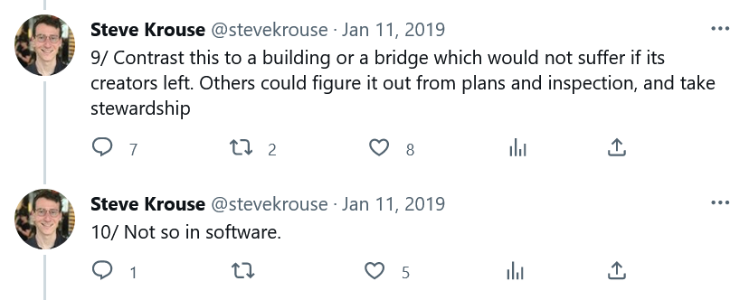

Slide 9


Notes:
Both only have a model of bridges

Slide 10
Notes:
Slide of a person imagining bride building

Slide 11

Notes:
https://thumbs.gfycat.com/OddRipeGoshawk-mobile.mp4

Slide 12
Mega Advertisement
Notes:
Can't monetize passion: falling into really deep rabbit holes

Slide 13
Let's talk to engineers!
Notes:
I didn't feel comfortable just talking to engineers and saying "it looks like software"

Slide 14
Crossover: someone who knows both software and "real" engineering.
Notes:
Compare CS as it is practiced to engineering as it is idealized

Slide 15
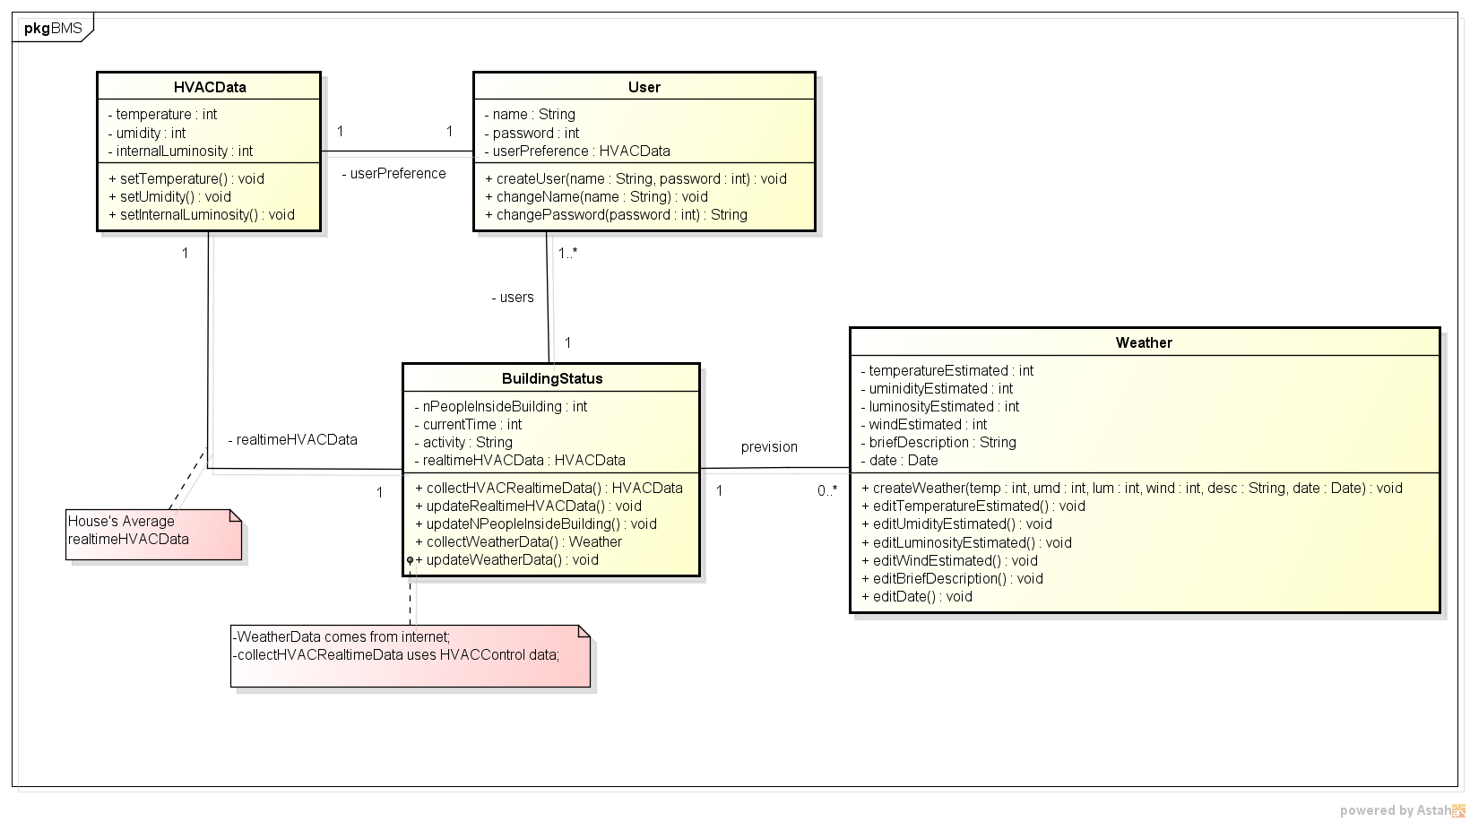
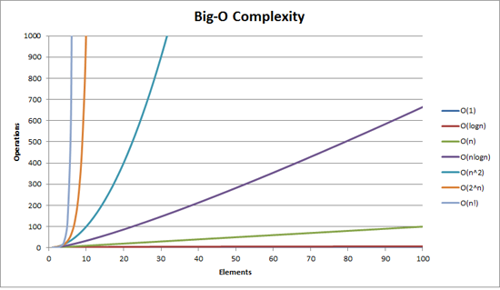

Slide 16
Crossover: someone who knows both software and "real" engineering.

Slide 17
Crossover: someone who worked in both software and "real" engineering.
Notes:
Compare CS as it is practiced to engineering as it is idealized

Slide 18
Are we really engineers?
How similar are we to engineers?
What can we learn from each other?

Slide 19

Notes:
I used twitter.

Slide 20


17
6
12
Notes:
Everything I will talk about is based on these interviews. They span 17 people

Slide 21
I. Are we really engineers?
Notes:
And it turns out, that's not the right question.

Slide 22
What is "engineering"?
Notes:
People normally think of

Slide 23



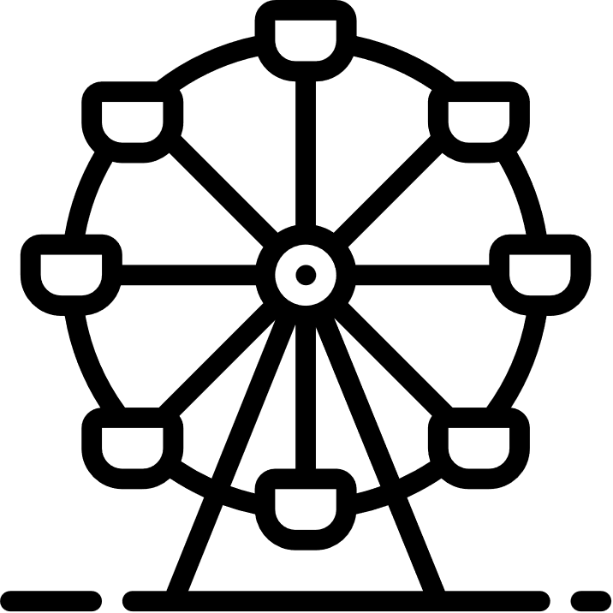

"Anything required for a living city"
"Anything required for a living city"
20%
Notes:
Bridges, buildings, roads, misc
Australia: 33% graduates https://www.aced.edu.au/downloads/ACED%20Graduates%20by%20Branch%20of%20Engineering%20May%202021%20-%20RKing.pdf

Slide 24
Mechanical
Electrical
Chemical
Industrial
Nuclear
Aerospace
20%
Notes:
When you look at the diversity…
Three common assumptions

Slide 25
Engineering is:
physical
consequential
licensed
Notes:
Misconceptions. Not the only misconceptions, but easy ones to introduce now

Slide 26
a. "Engineering is physical."
Notes:
One person I talked to was a "systems engineer". When I asked what that looked like, gave this description

Slide 27

Notes:
Airport radio communication with plane. Diff teams ∈ diff companies, had to get them to agree on interfaces (broadcast on band other couldn’t receive). Could already have made a choice.

Slide 28

Notes:
Antenna array had its own protocols and interfaces, and was already being built

Slide 29
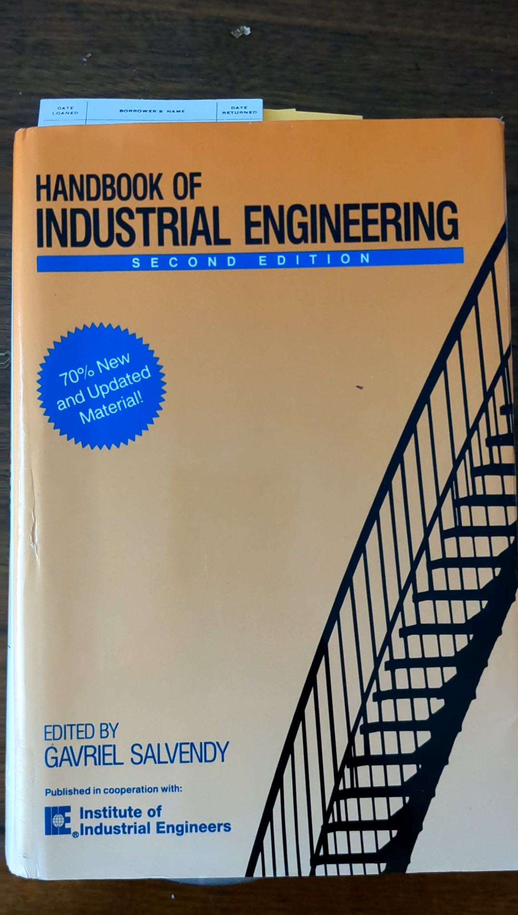
Notes:
Not bringing a THREE KILO BOOK in checked luggage

Slide 30
Uniqueness Principle
Each project should be regarded as different from previous seemingly similar projects.
People-Design Principle
Stakeholders must have a role in finding and implementing the solution.

Slide 31
Uniqueness Principle
Each project should be regarded as different from previous seemingly similar projects.
People-Design Principle
Stakeholders must have a role in finding and implementing the solution.
Agile

Slide 32
Engineering is:
physical
consequential
licensed

Slide 33
b. "Engineering is consequential."

Slide 34

Notes:
6,600 calls were dropped
“Although, fortunately, it appears that no one died as a result, the incident – and the flaws it revealed – is simply unacceptable”
000 in Australia

Slide 35





Notes:
One electrical engineer didn't, but coworker did. [Raise your hand]

Slide 36
Engineering is:
physical
consequential
licensed

Slide 37
c. "Engineering is licensed."

Slide 38
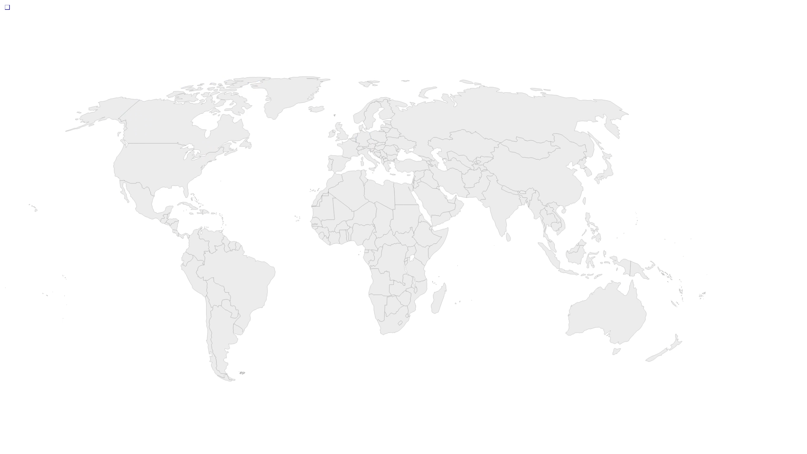
Notes:
Canada map: 0.5% of the world

Slide 39
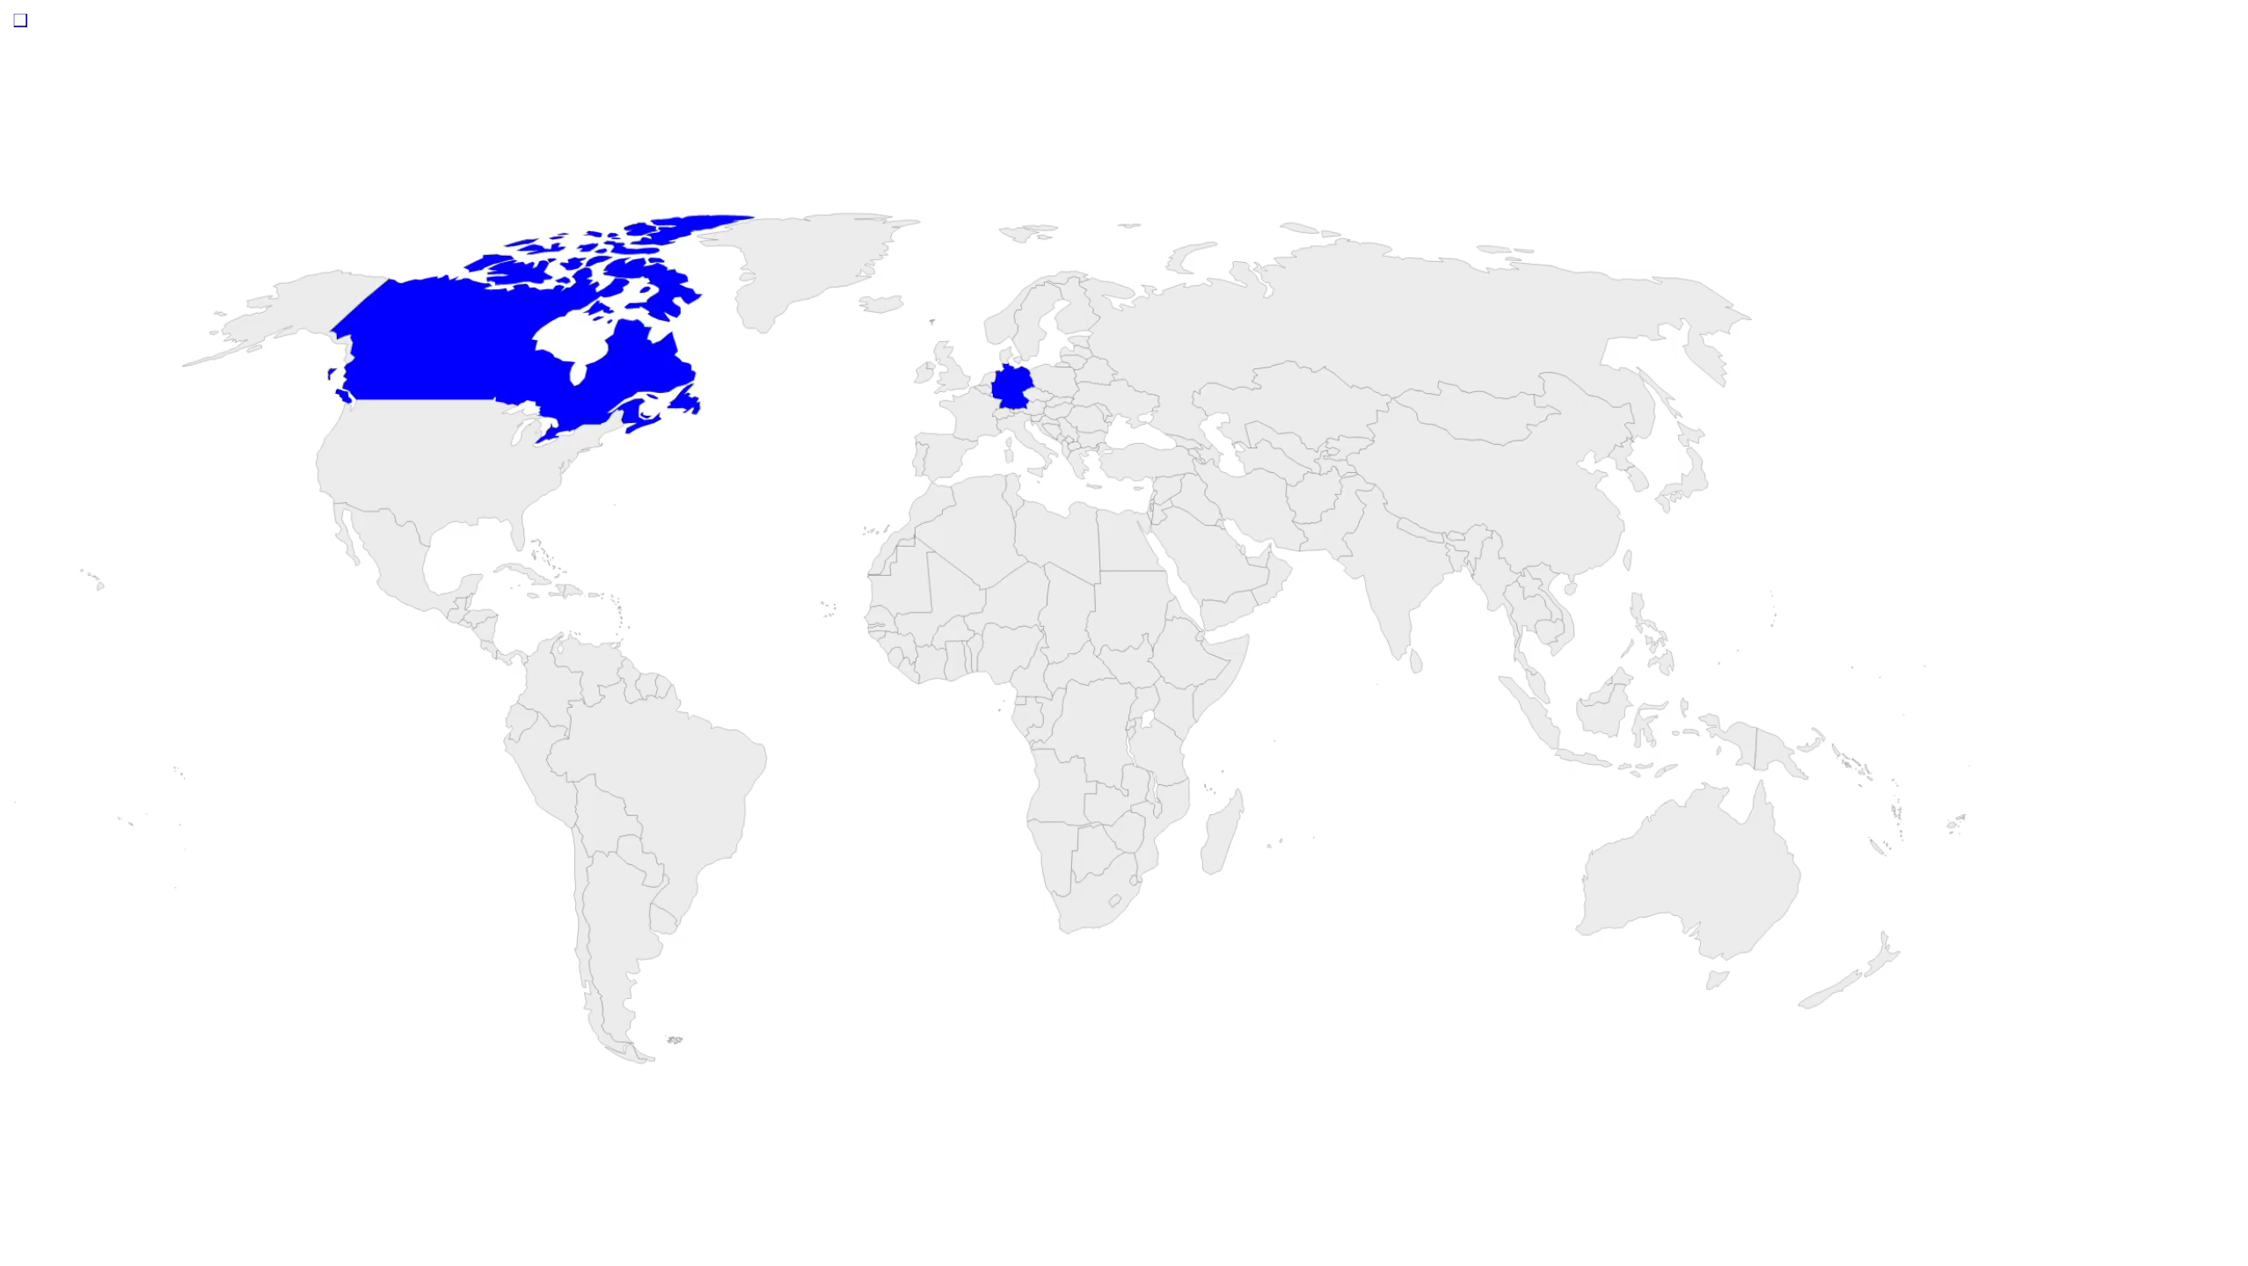

Slide 40
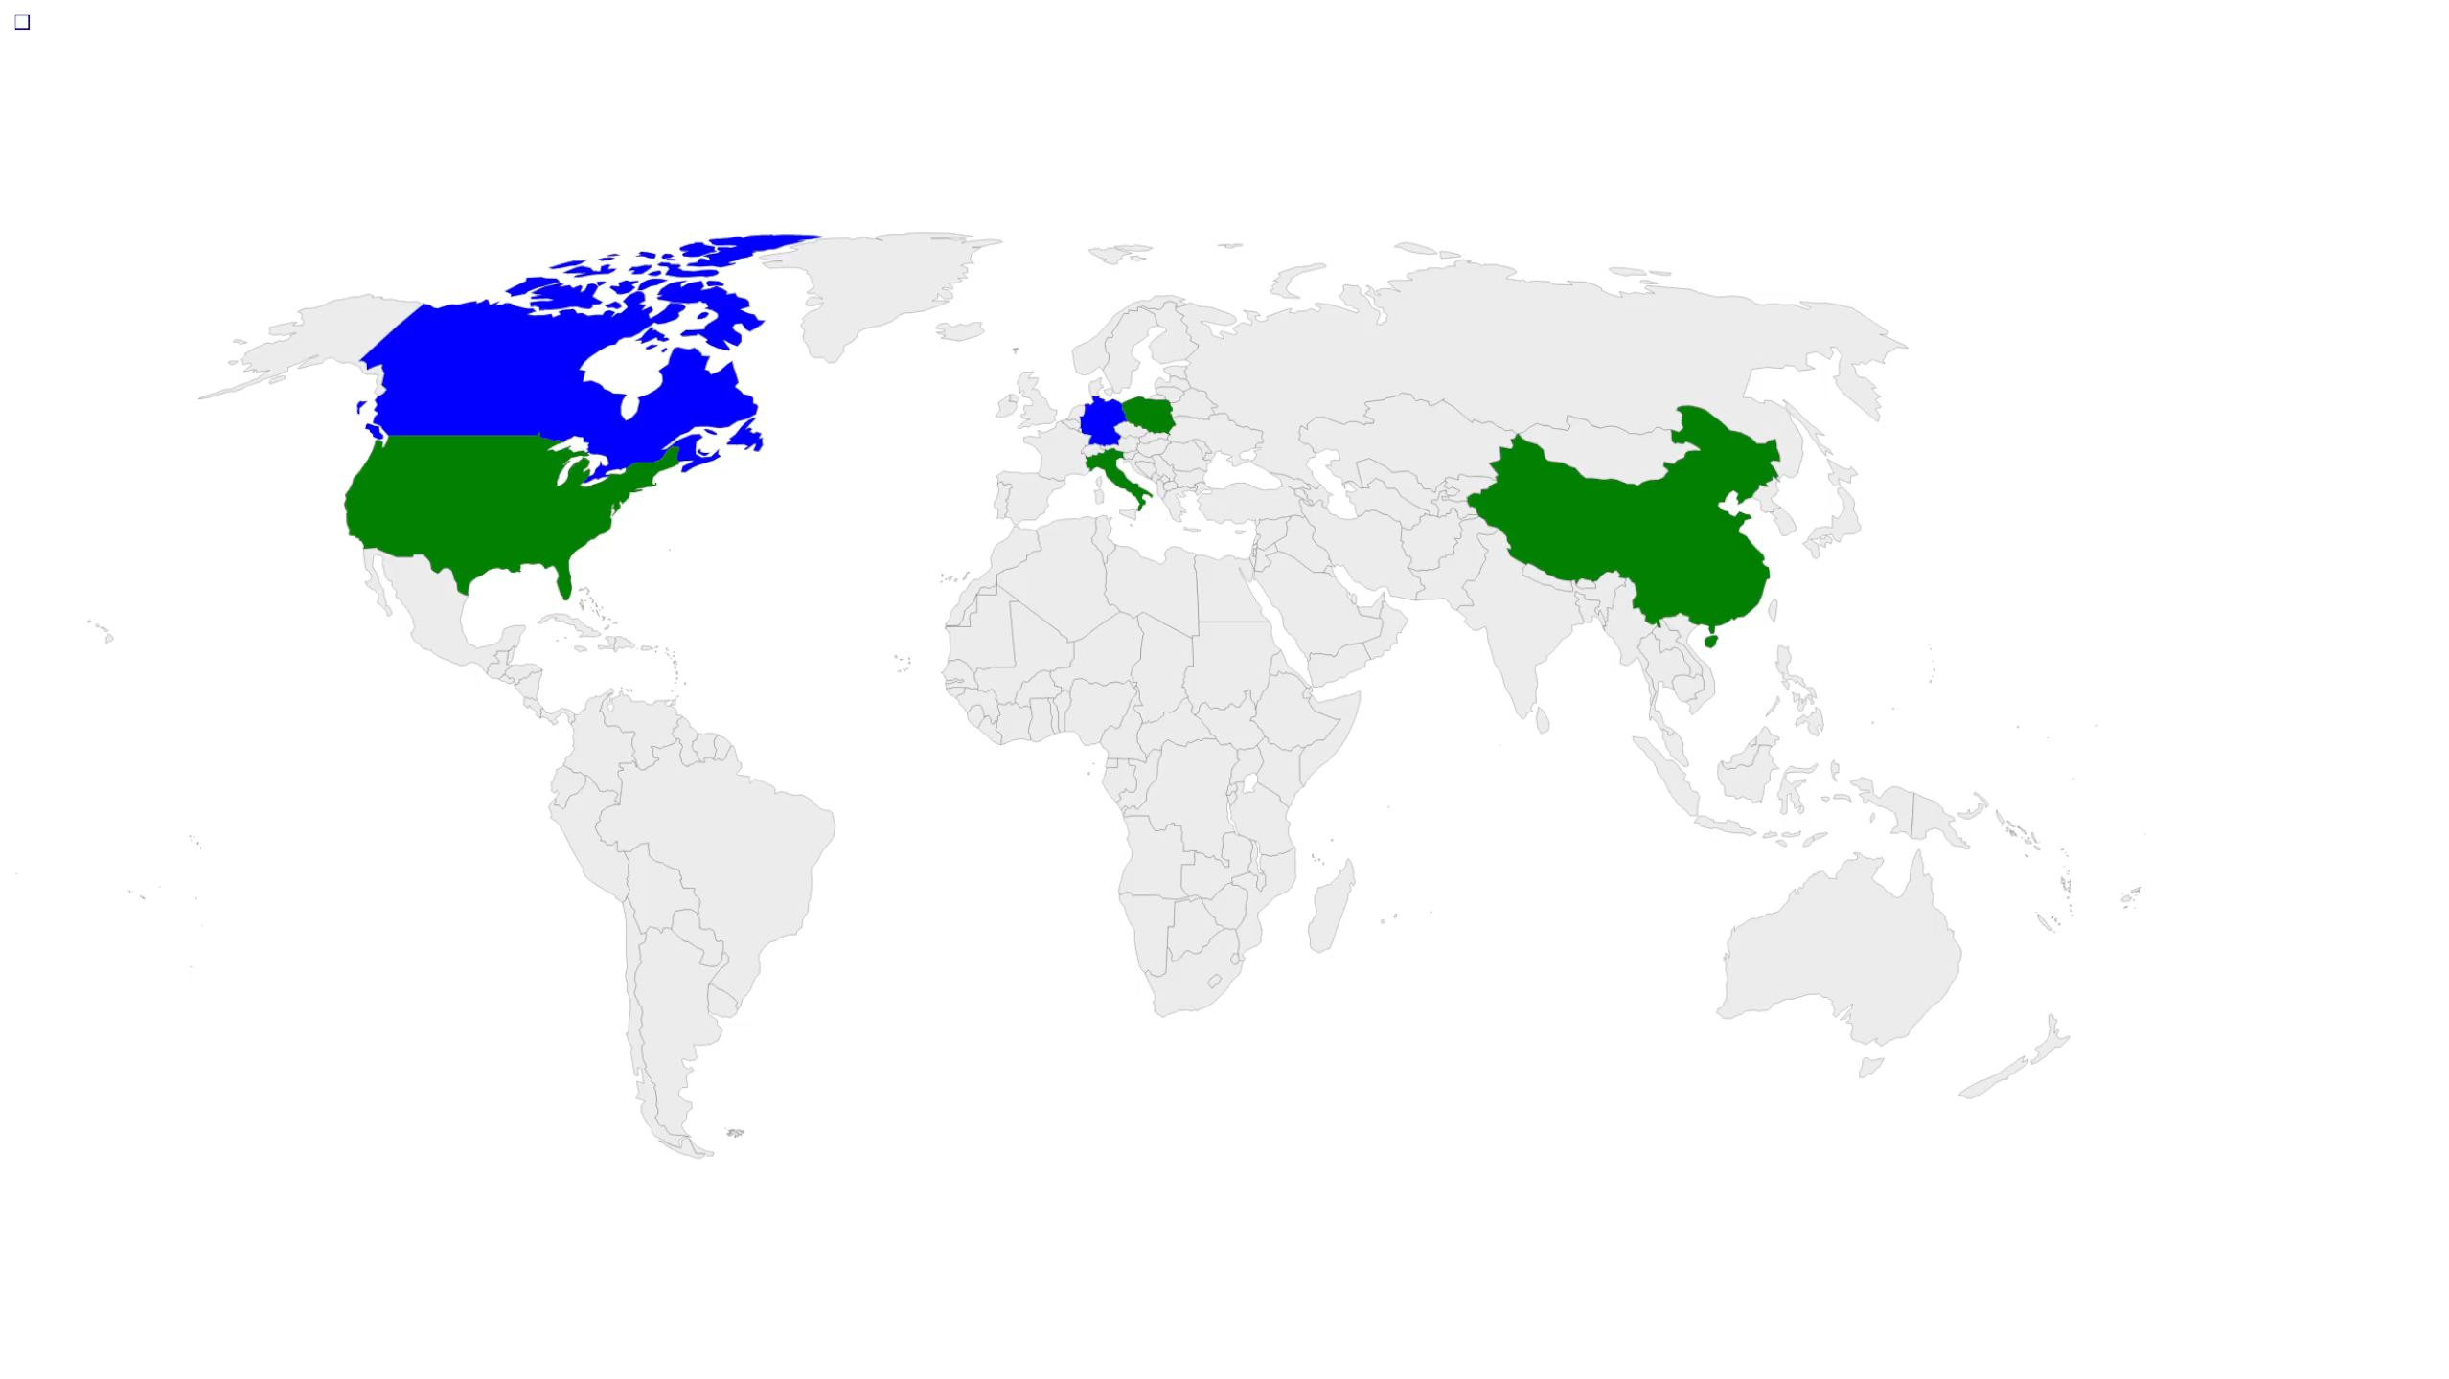
Notes:
Canada map: 0.5% of the world

Slide 41
Engineering is:
physical
consequential
licensed

Slide 42
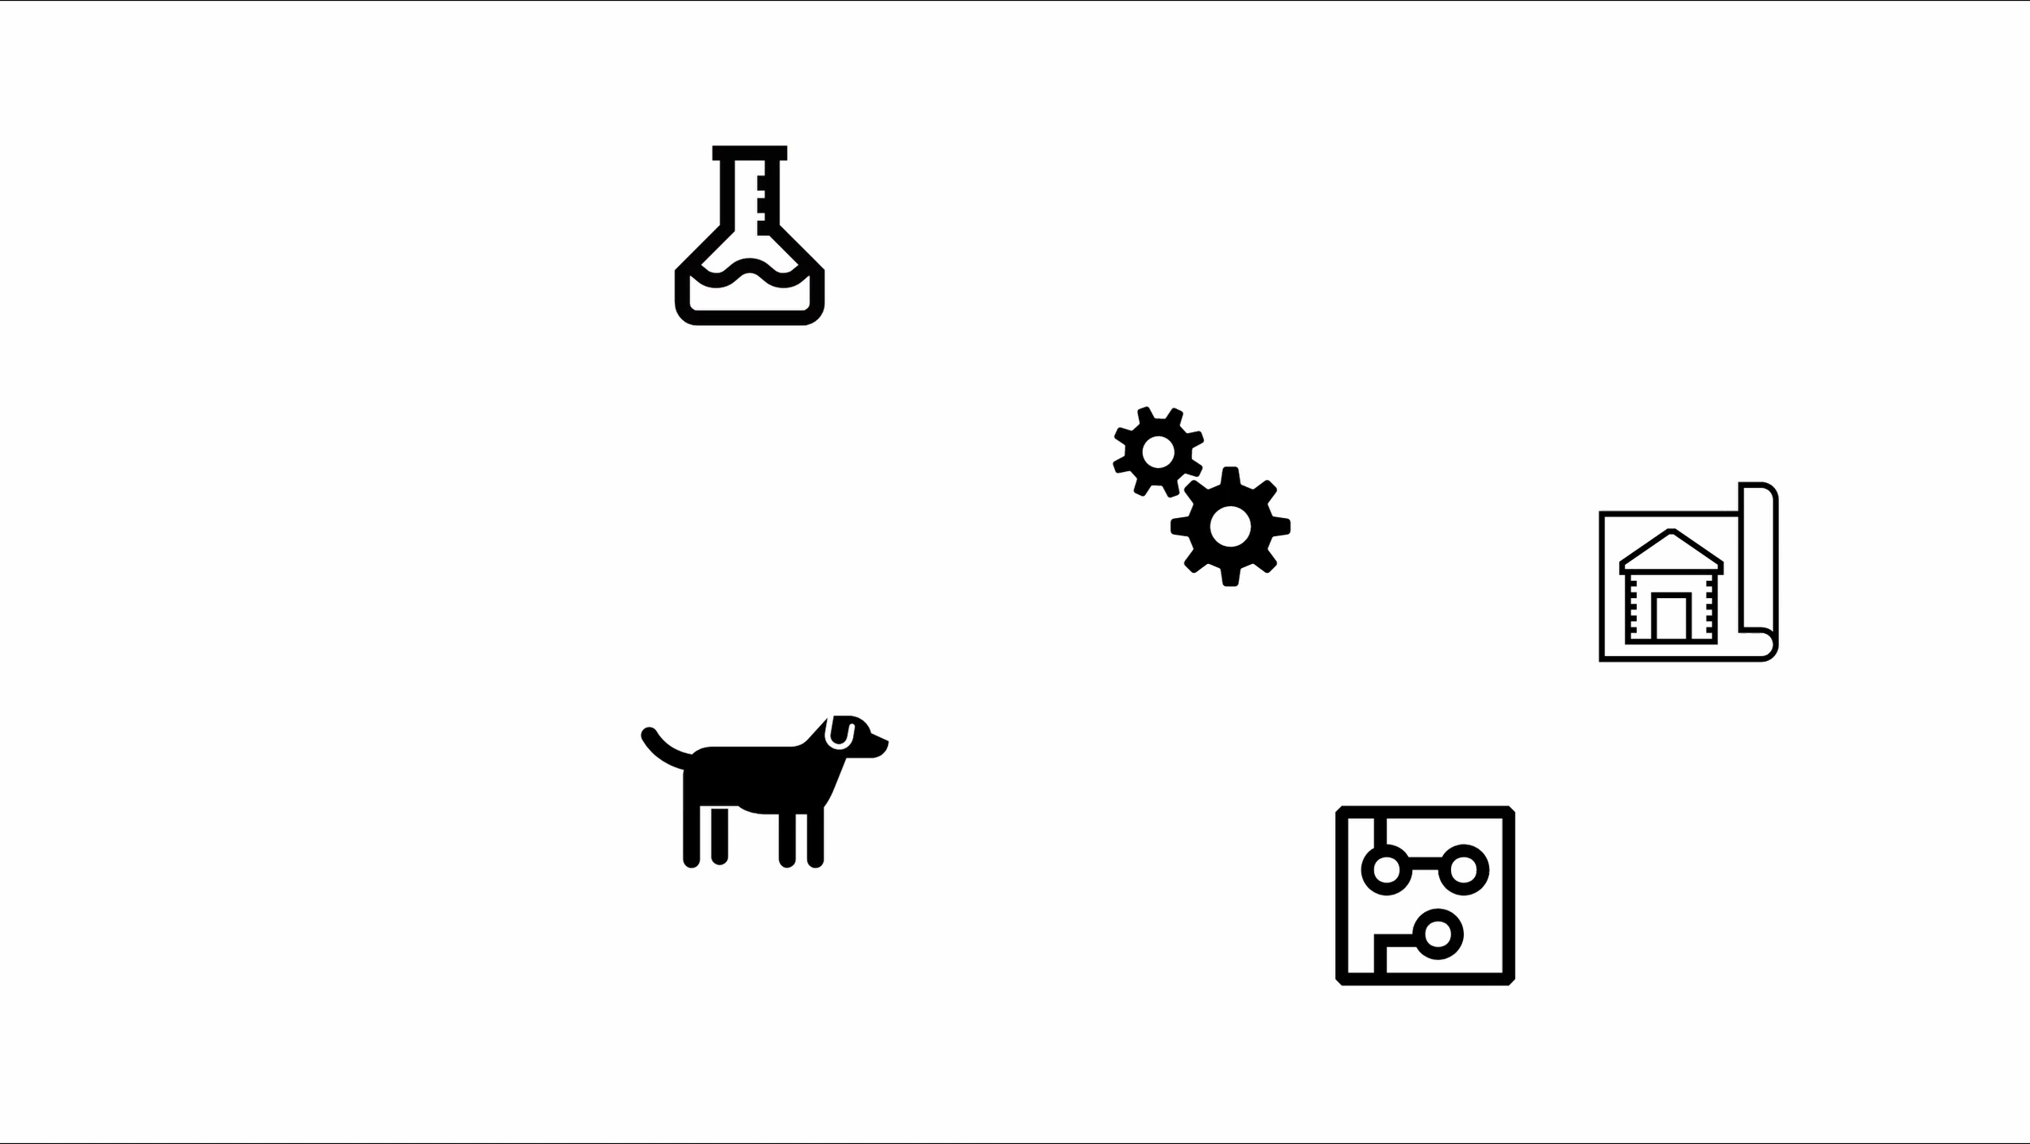

Slide 43
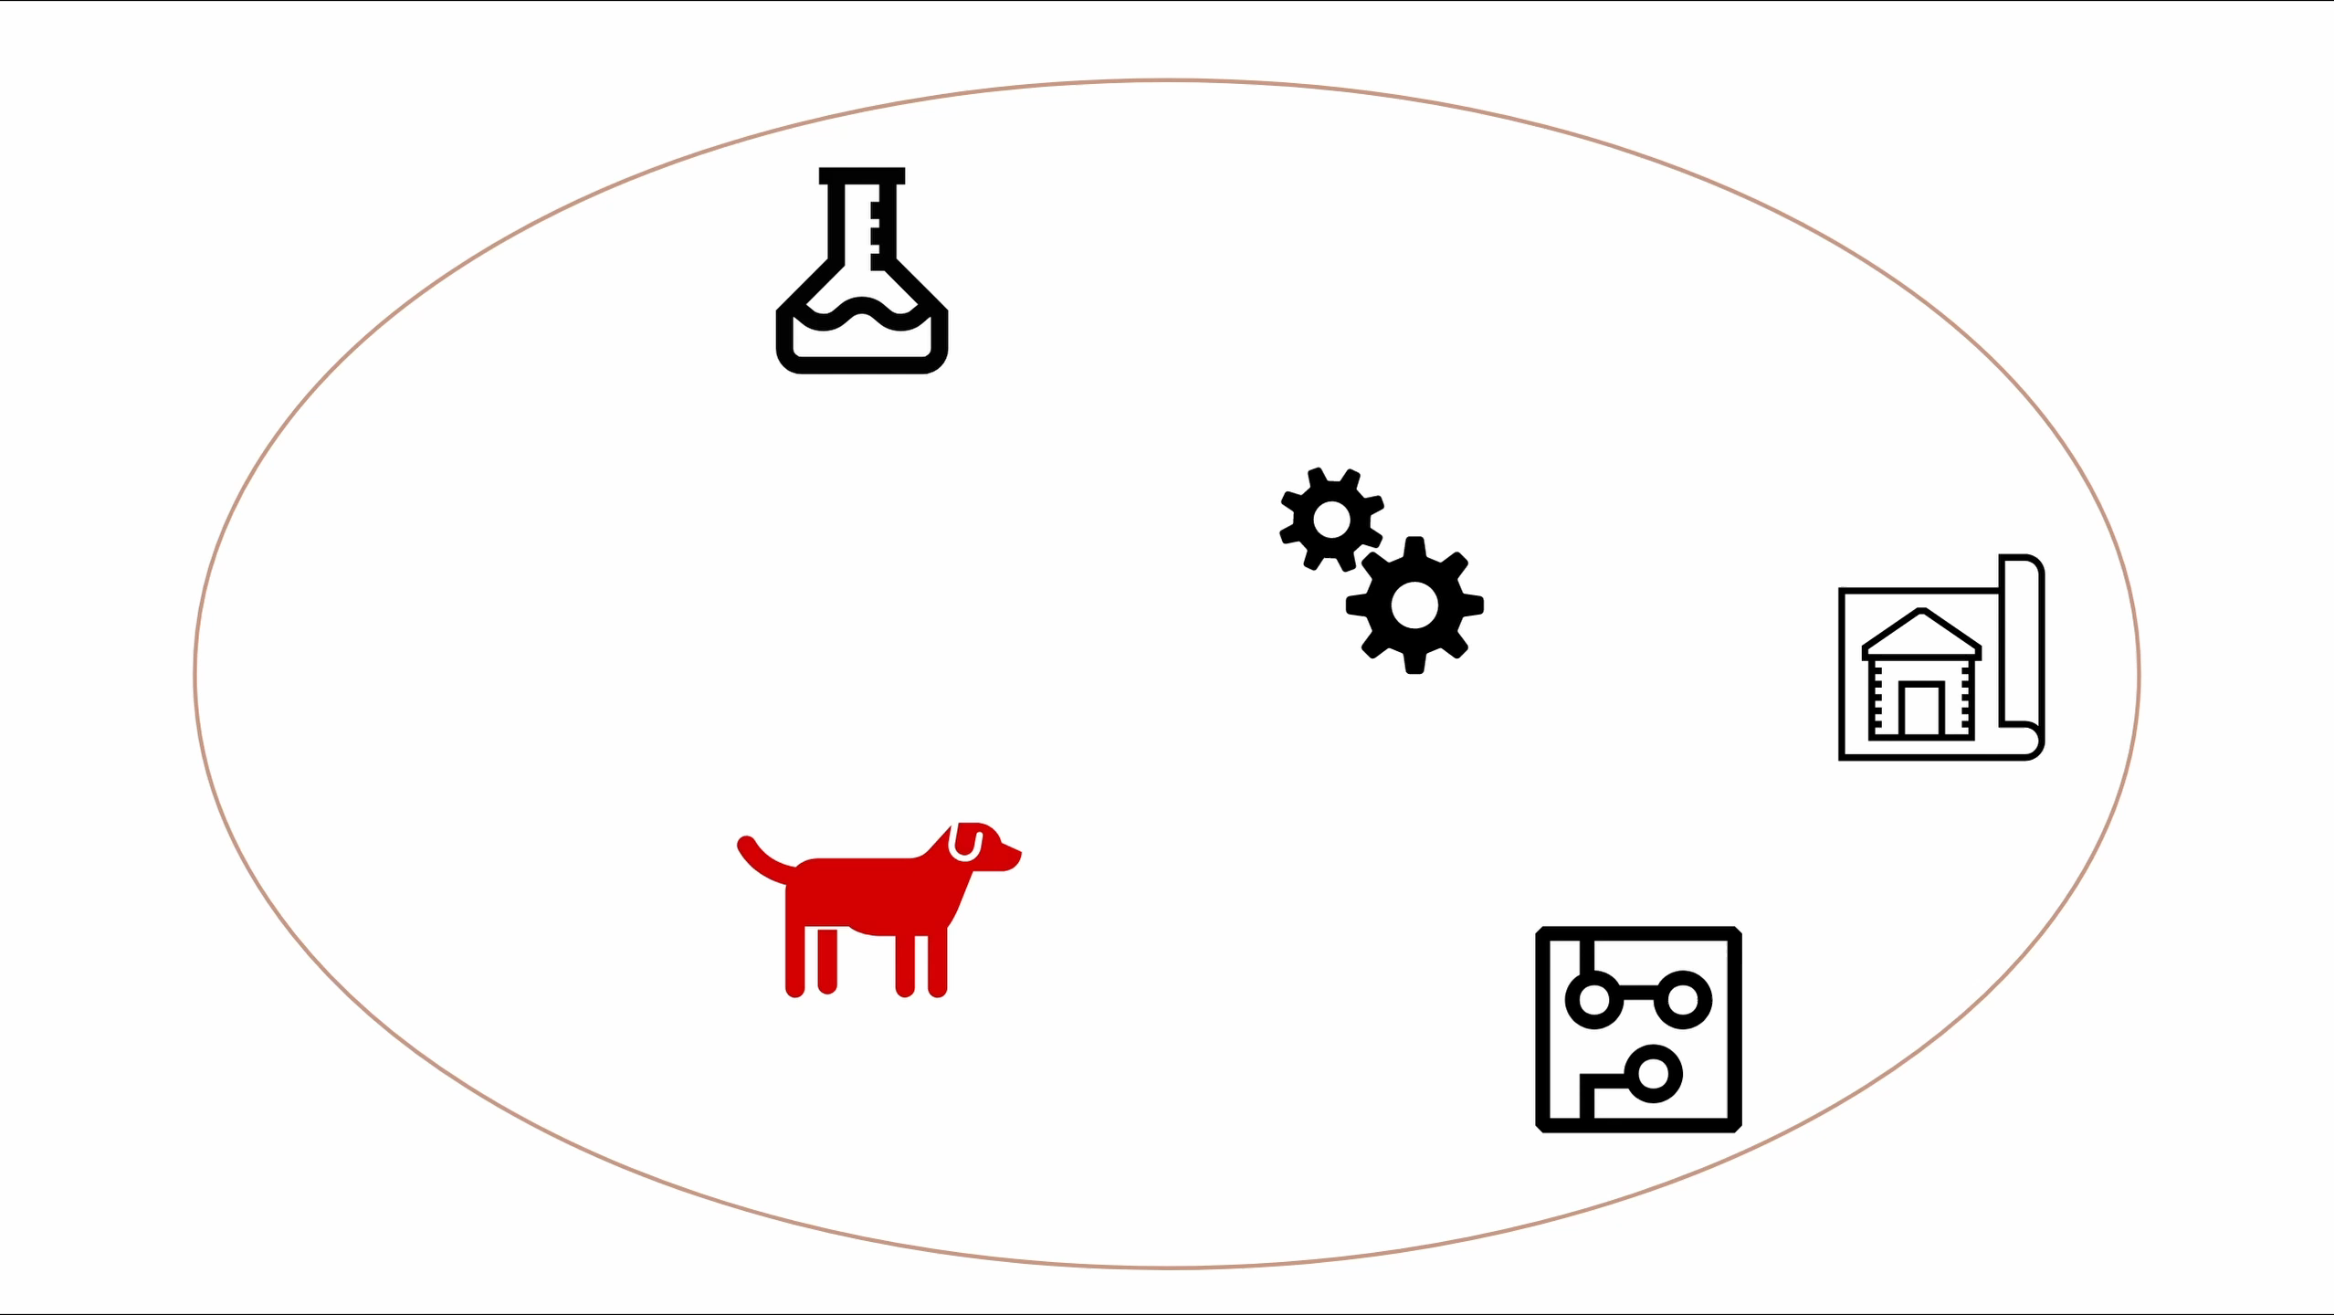

Slide 44
Engineering is:
physical
consequential
licensed
d. what engineers do.

Slide 45
Notes:
Not expecting this result, [start using TRAD]

Slide 46
Engineering
Electrical Engineer
Software Engineer
Electrician
???
Tradecraft Traddies
Tradecraft
Notes:
The gap is much closer between us, for reasons I'll talk about
Engineering vs trade work

Slide 47
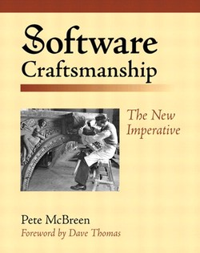
Notes:
Very negative view of engineering
[Have EXACT quotes]

Slide 48
II. How is Software Different from Trad?

Slide 49
Are We Special?
Notes:
We have this idea that software is a totally unique field, engineering practices don’t apply

Slide 50


Slide 51
Software | Traditional
Agile | Waterfall
Unpredictable | Predictable
Informal | Rigorous

Slide 52
1. Software is agile

Slide 53


Slide 54
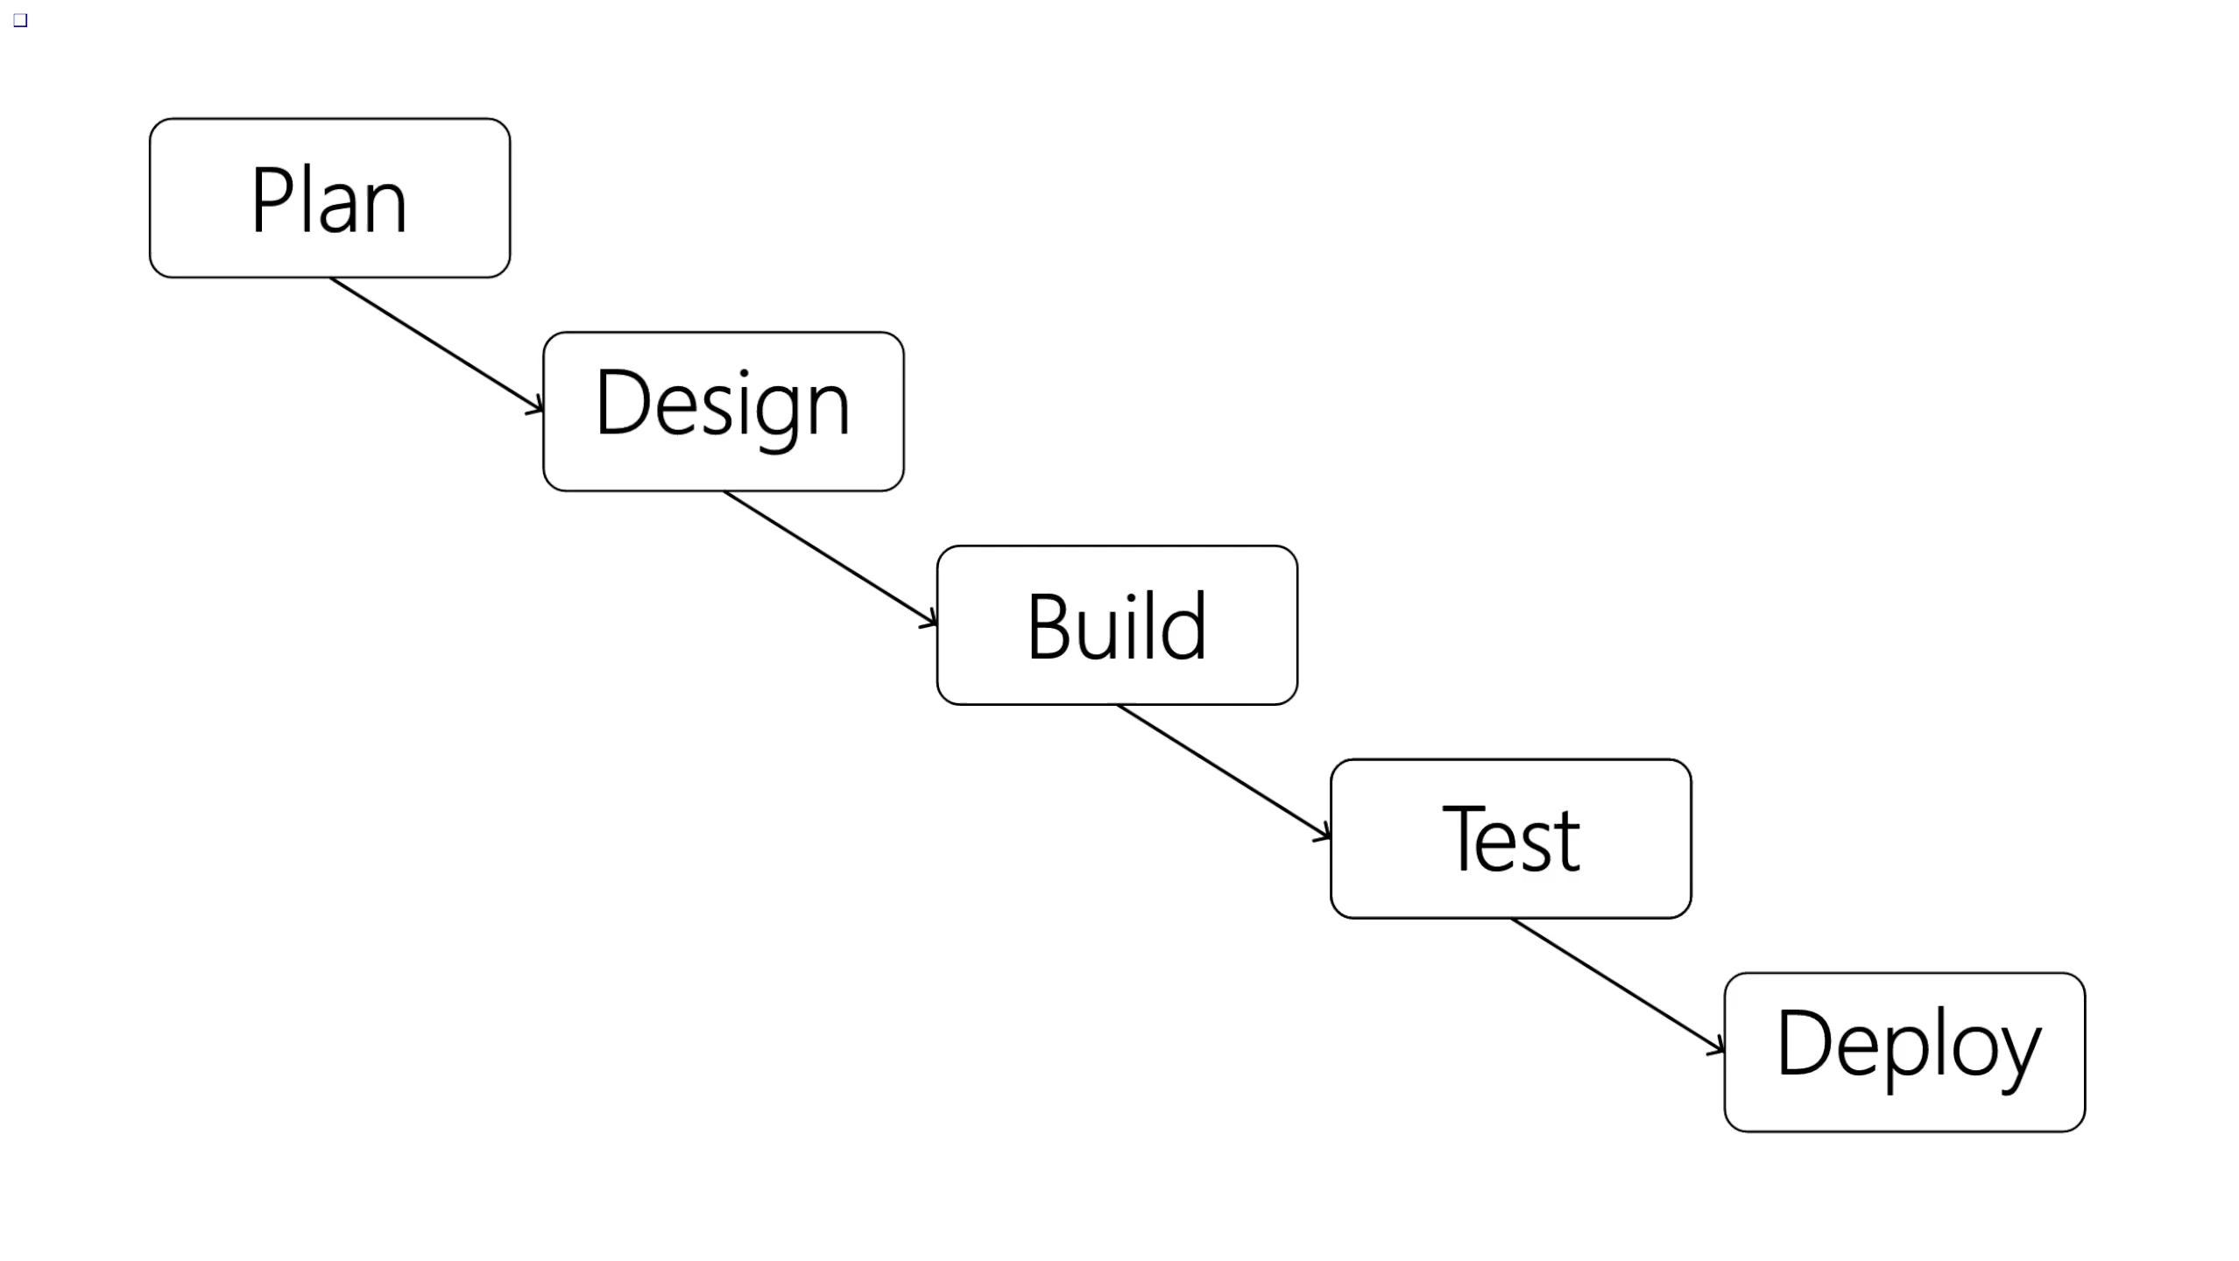

Slide 55







Waterfall
¯\_(ツ)_/¯
Agile
Notes:
Nobody does Waterfall if they can avoid it.

Slide 56
2. Engineering is predictable

Slide 57
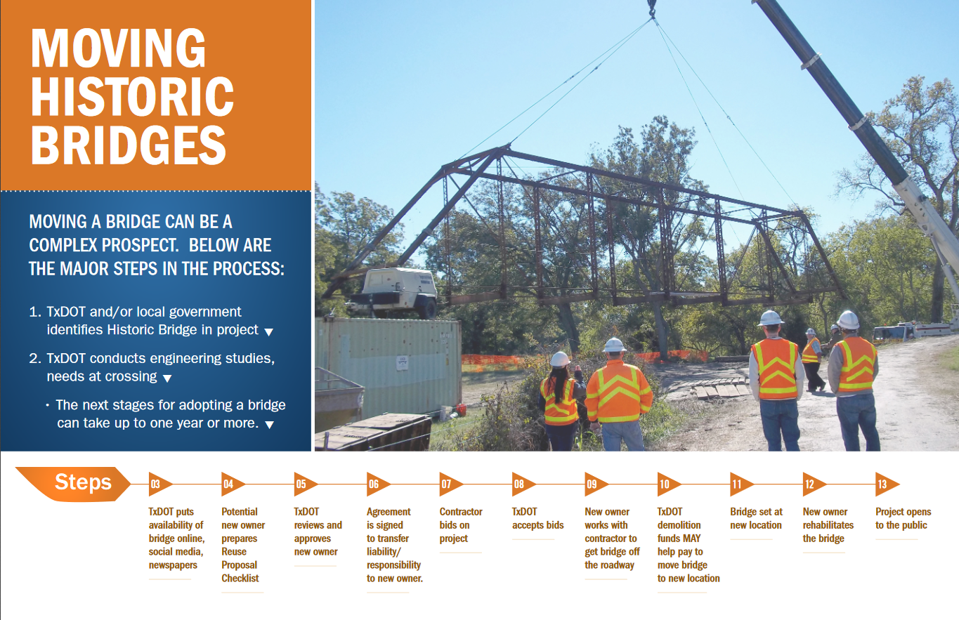
Guide on how to move bridges
Notes:
https://ftp.dot.state.tx.us/pub/txdot-info/env/historic-bridges/moving-process.pdf

Slide 58
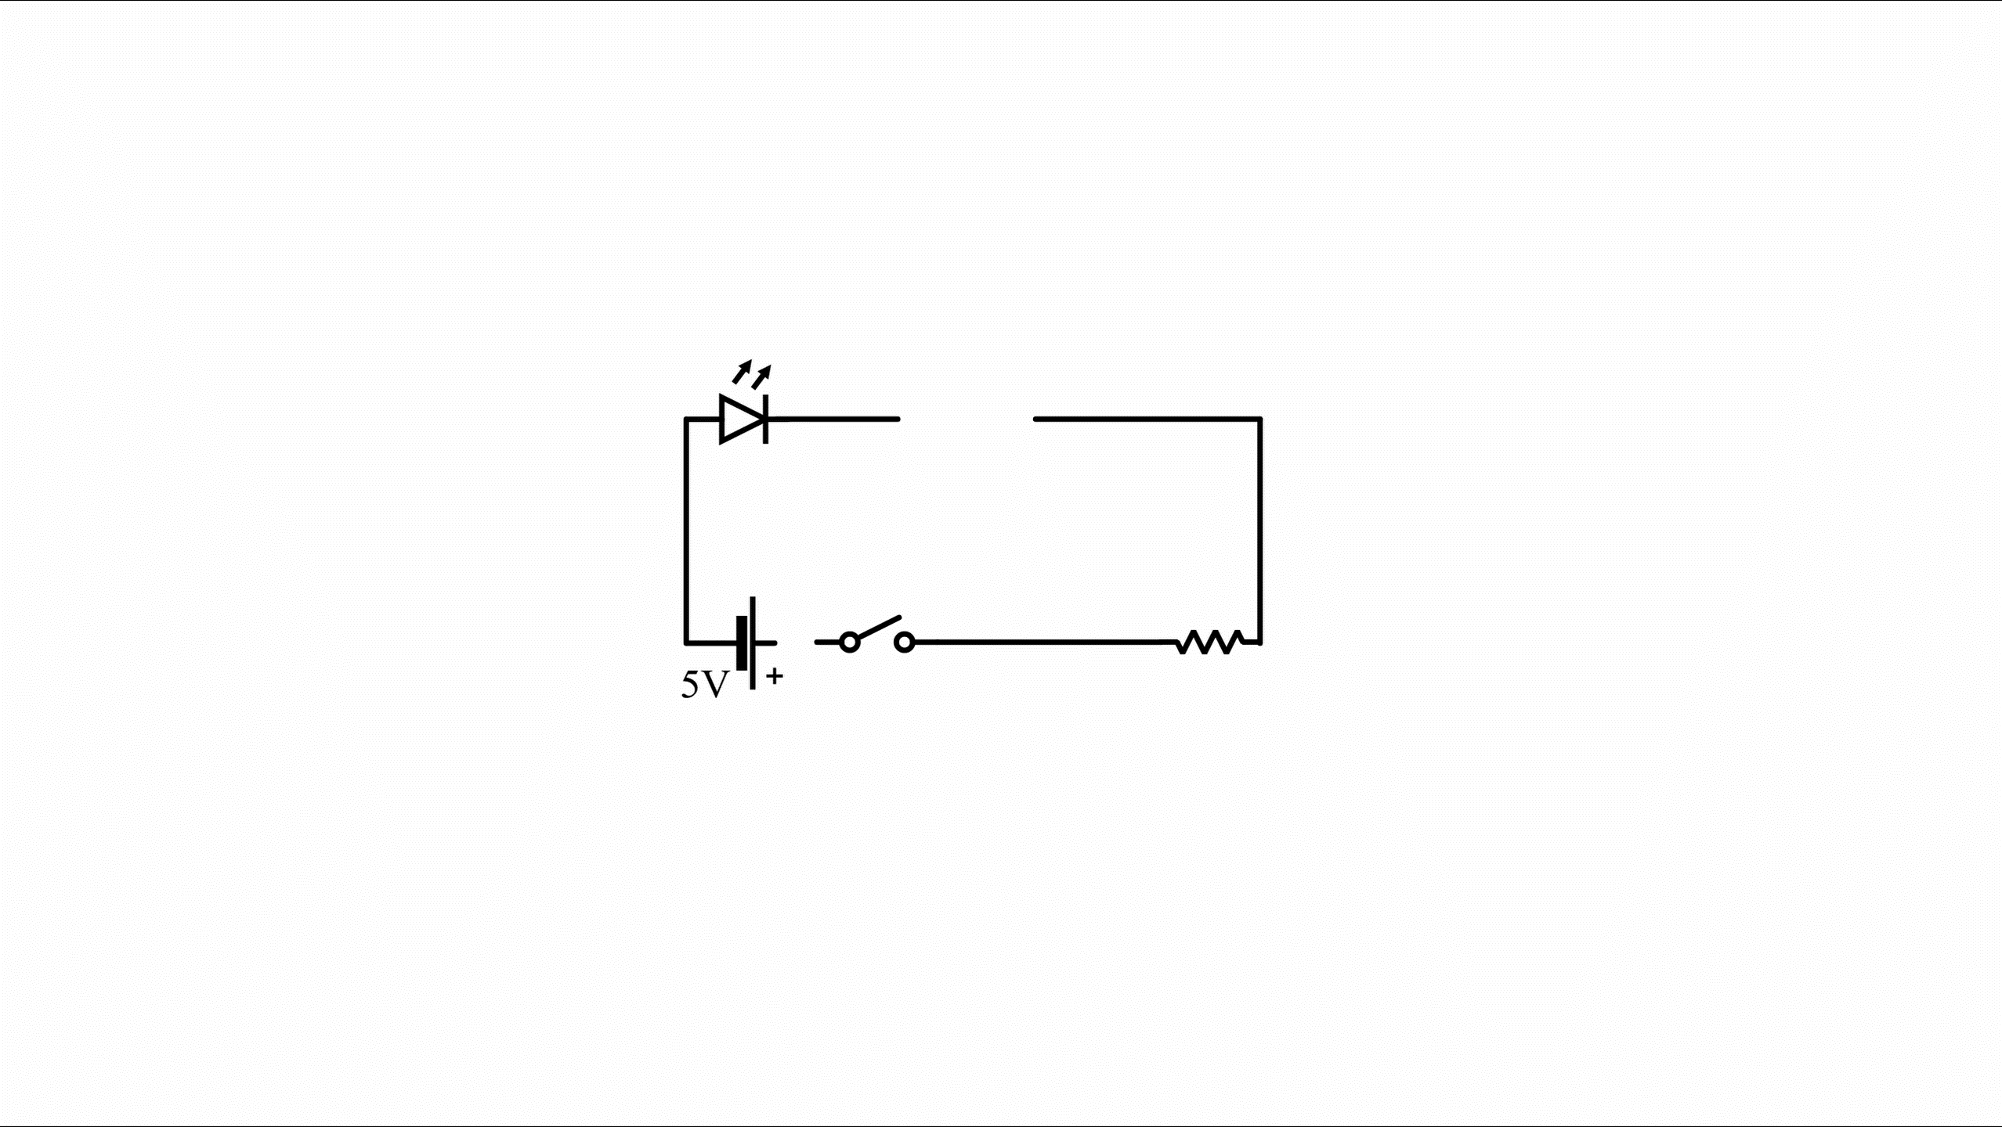
Notes:
microcontroller

Slide 59
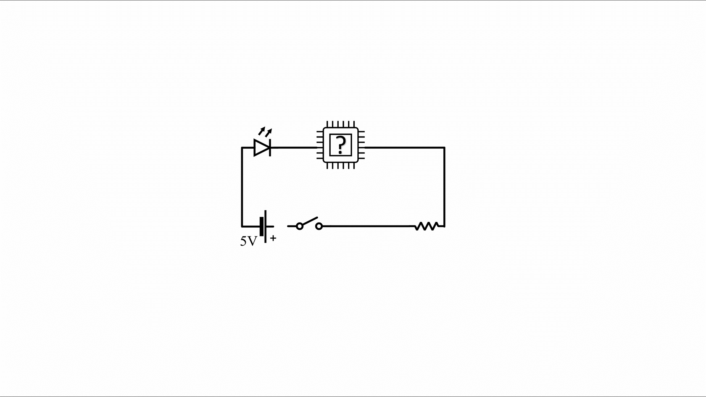
Notes:
1000 fit requirements
Most couldn’t be bought in bulk, needed 5000

Slide 60
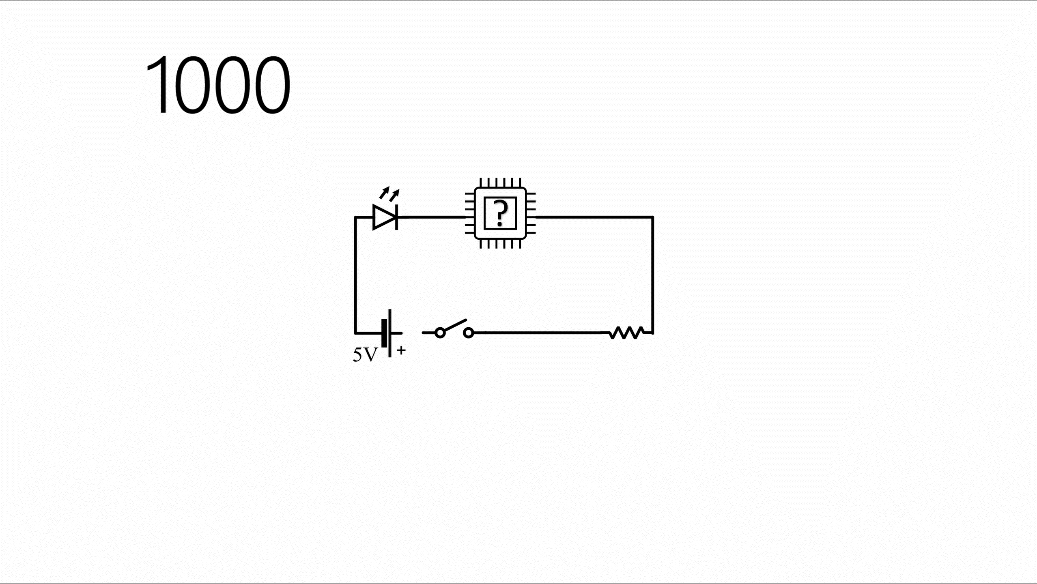
Notes:
Couldn't find timely suppliers for most of them

Slide 61
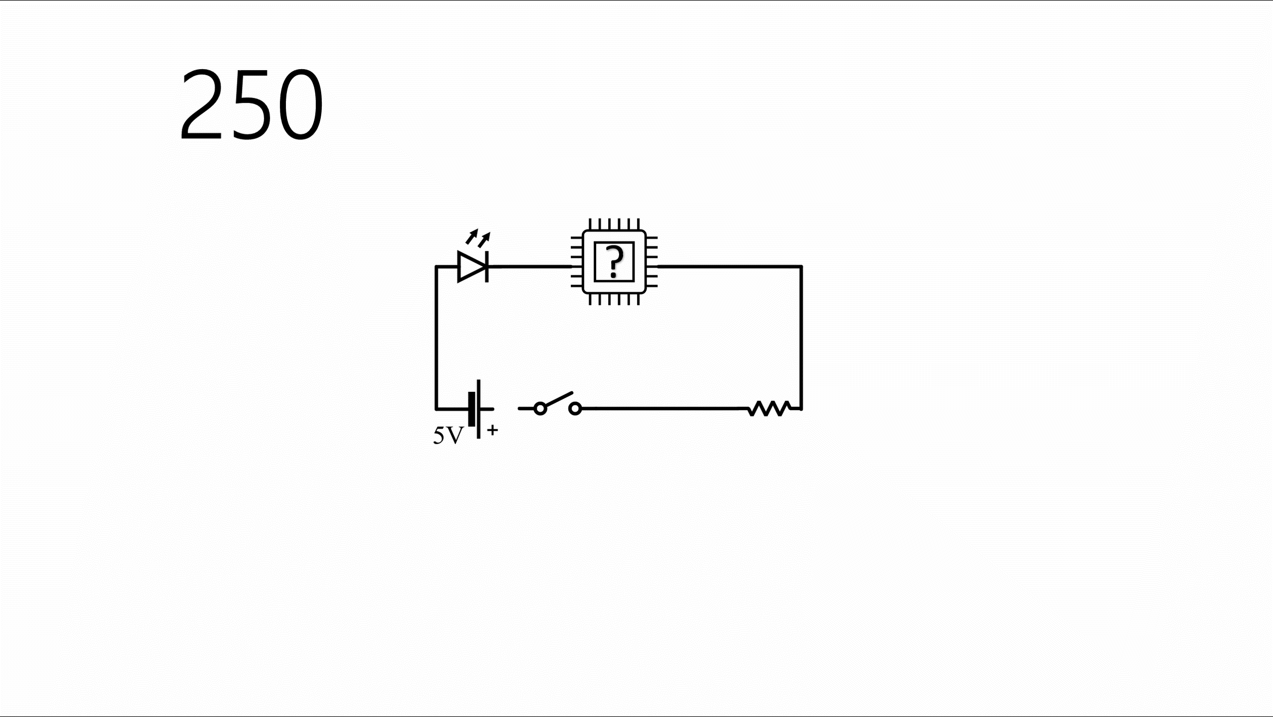
Notes:
Only had experience with one

Slide 62
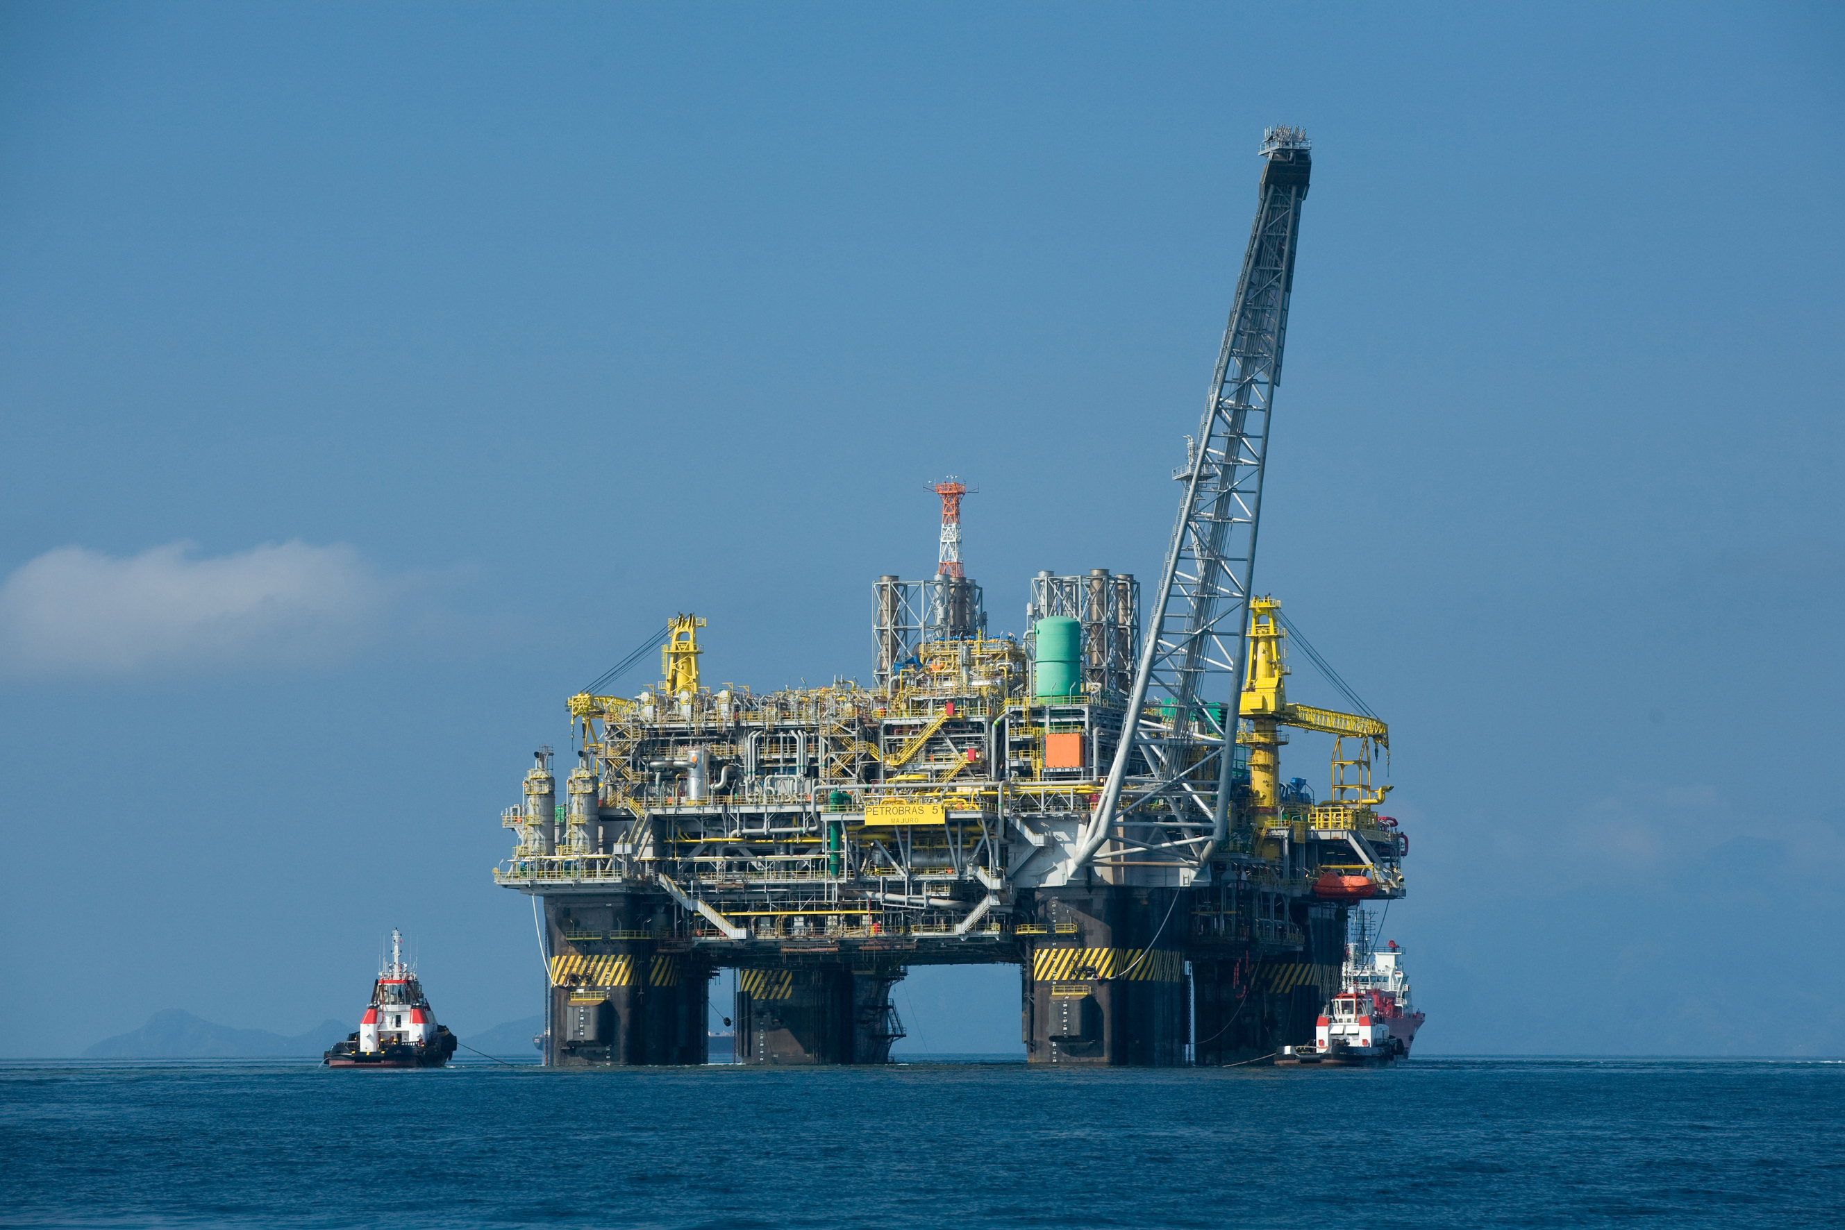
Notes:
https://en.wikipedia.org/wiki/File:Oil_platform_P-51_(Brazil).jpg

Slide 63
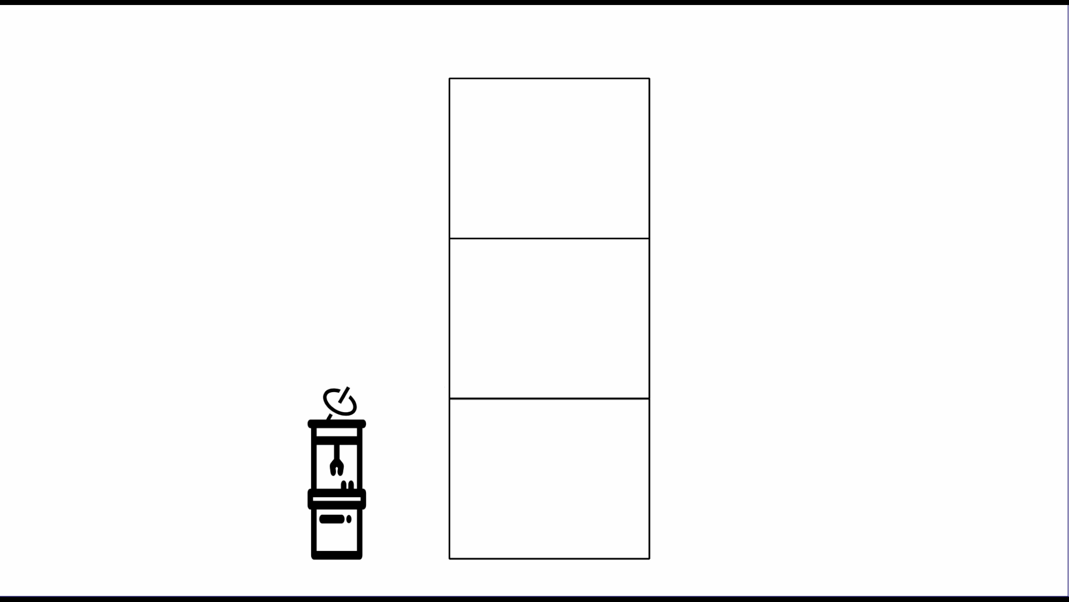

Slide 64
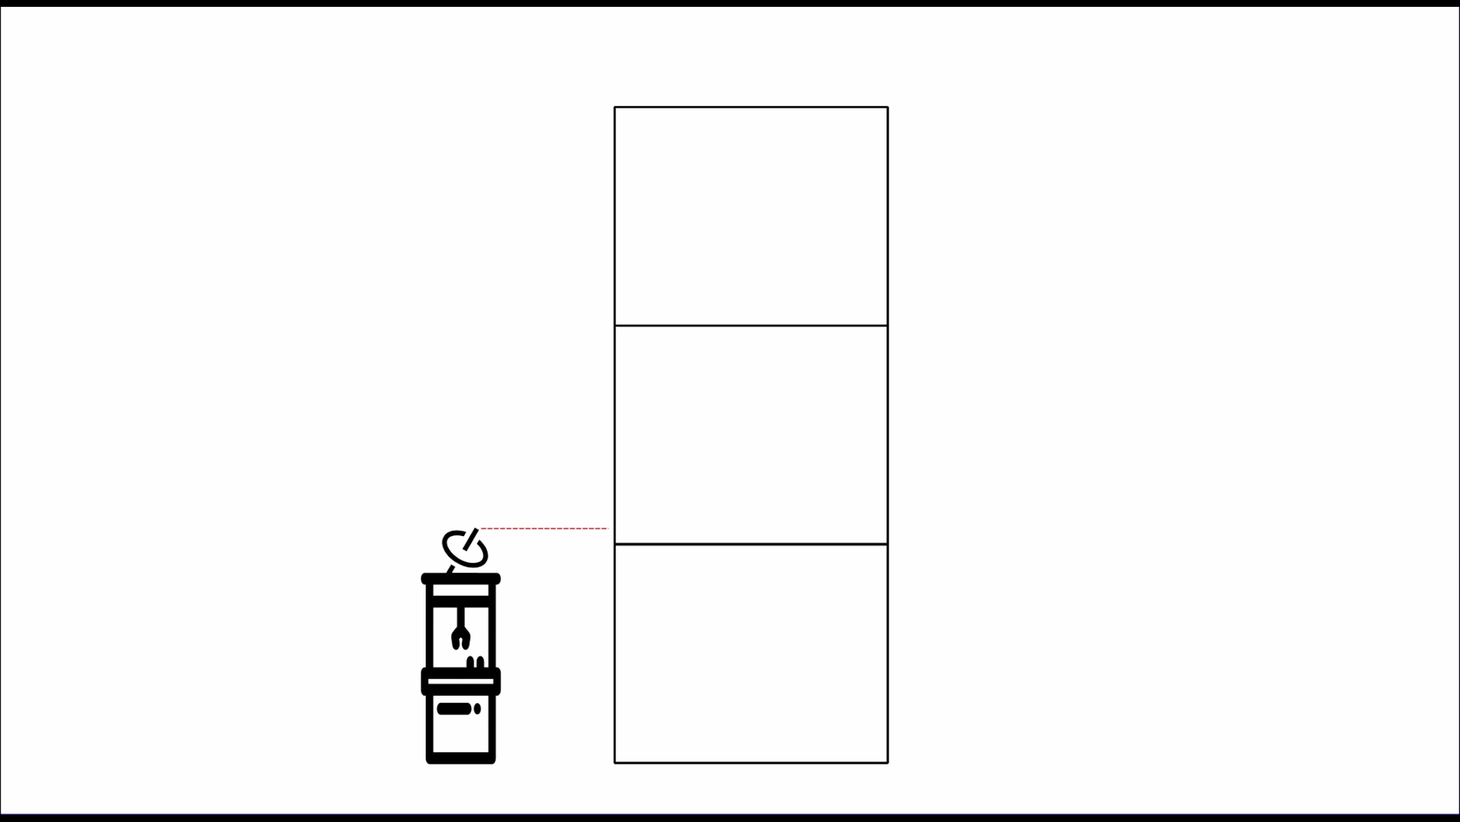

Slide 65
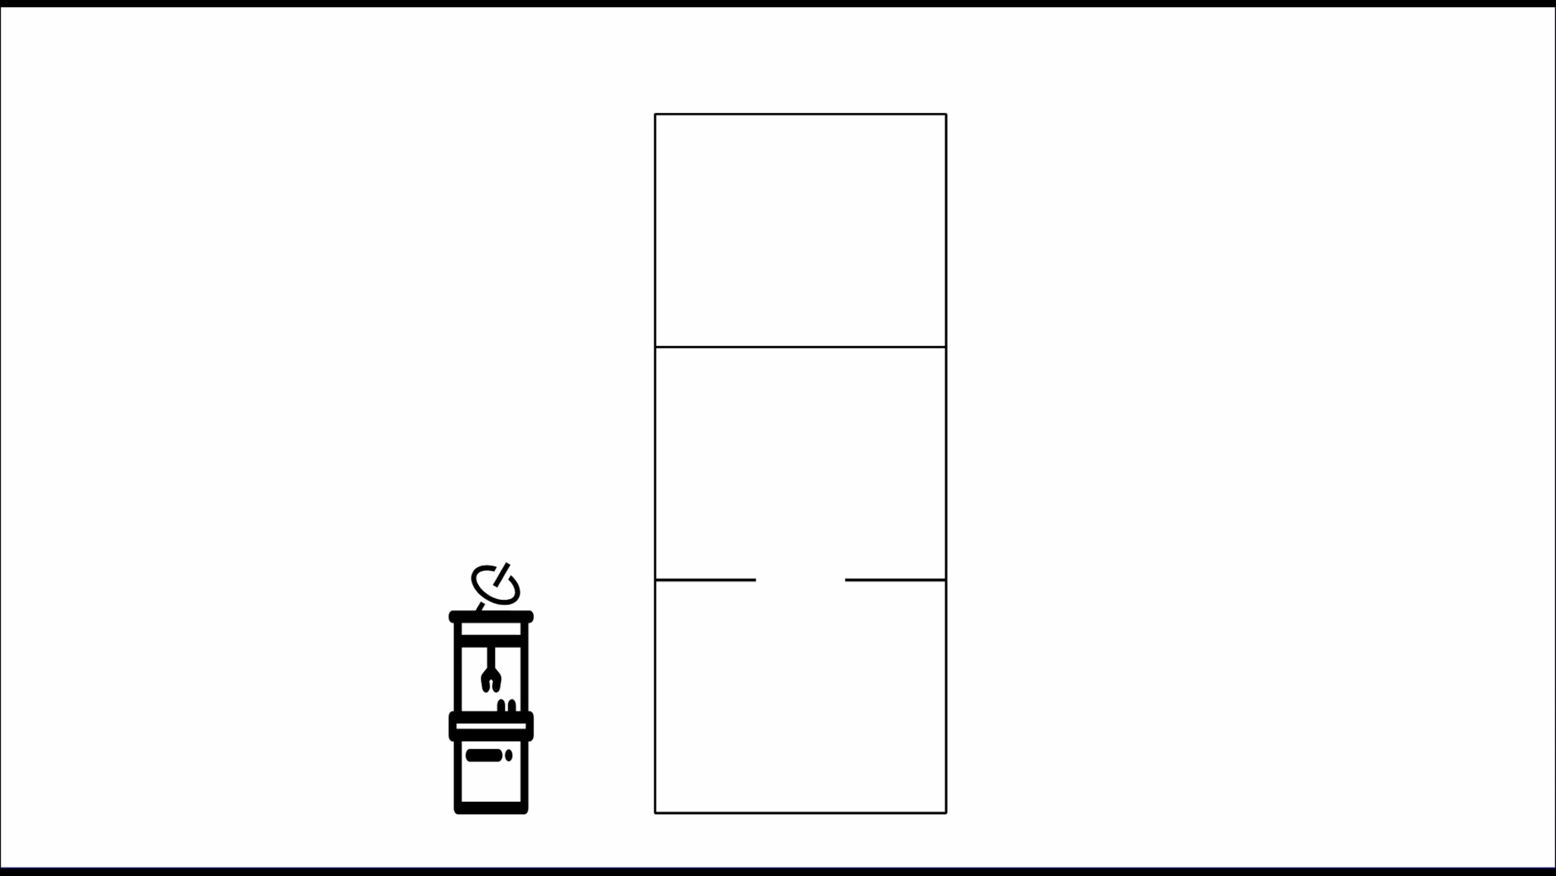

Slide 66
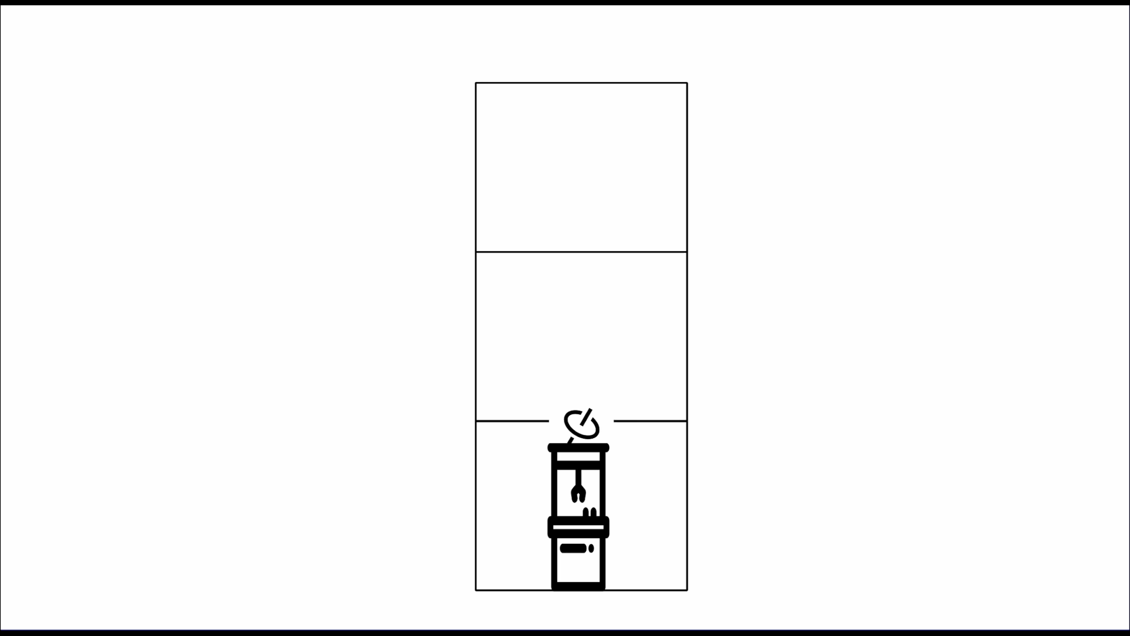

Slide 67




Slide 68







Slide 70
New Austrian Tunneling Method

Slide 71
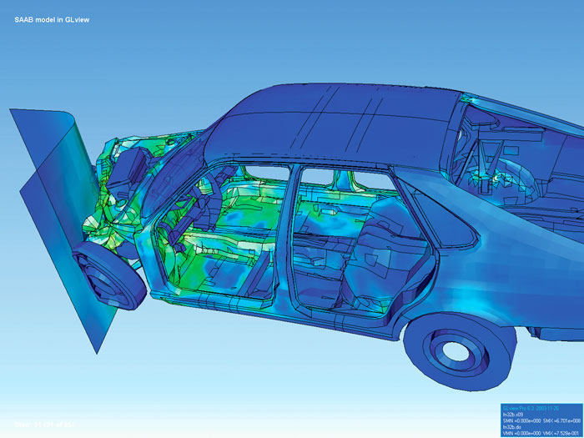

Slide 72
3. Engineering is more rigorous
Notes:
Based on the cost of iteration
Fob off on the software engineers

Slide 73


Slide 74


Slide 75


Slide 76

Notes:
But the best way is to often have software fix it

Slide 77
Project? | Software Fix?
P01 | ☑️
P02 | ☑️
P03 | ☑️
P04 | ☑️
…
P760 | ☑️

Slide 78
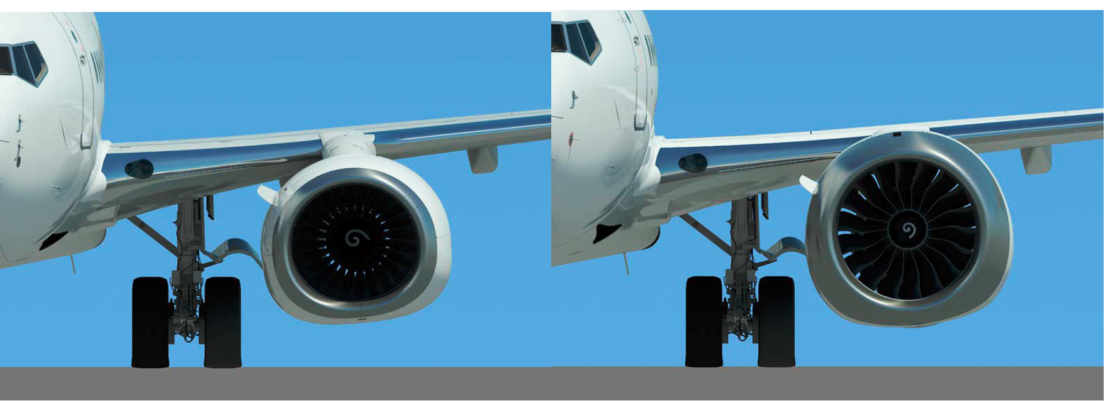
Notes:
MCAS flight-stabilization

Slide 79
Software | Traditional
Agile | Waterfall
Unpredictable | Predictable
Informal | Rigorous

Slide 80
Software | Traditional
Iterative | Iterative
Unpredictable | Unpredictable
Informal | (sometimes) Informal

Slide 81
What's Different?

Slide 82
What's Different?
Velocity

Slide 83
What's Different?
Velocity
Constraints

Slide 84

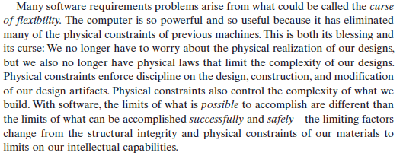
Notes:
Page 50

Slide 85

1
2
3
4

Slide 86
What's Different?
Velocity
Constraints
Consistency

Slide 87
def sort(l):
if l == []:
return l
lo = [x for x in l if x < l[0]]
fs = [x for x in l if x == l[0]]
hi = [x for x in l if x > l[0]]
return sort(lo) + fs + sort(hi)
Notes:
47 uF

Slide 88
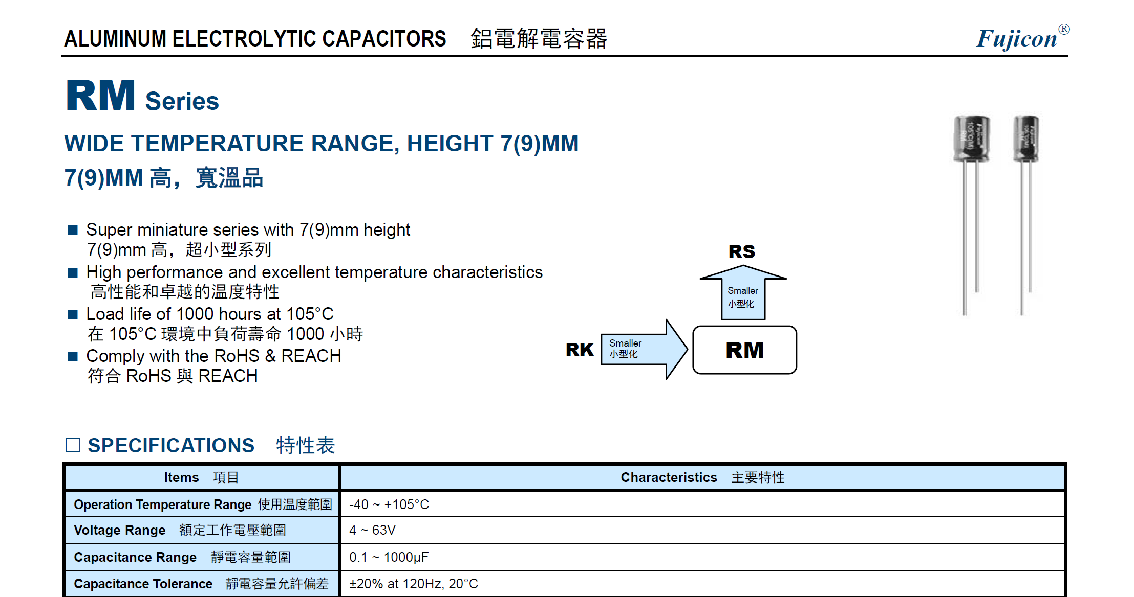
Notes:
(37 56)
Consistency profoundly

Slide 89



Slide 90
Software | Traditional
Iterative | Iterative
Unpredictable | Unpredictable
Informal | (sometimes) Informal
Rapid | Slower
Consistent | Inconsistent
Unconstrained | Constrained

Slide 91
So are we special?

Slide 92
No.

Slide 93
What can we learn from each other?
Quite a lot, actually
Notes:
When you put people on the spot, they can't tell you much.
Snap fit handbook

Slide 94
What we can learn
Up-front planning time
Responsibility

Slide 95
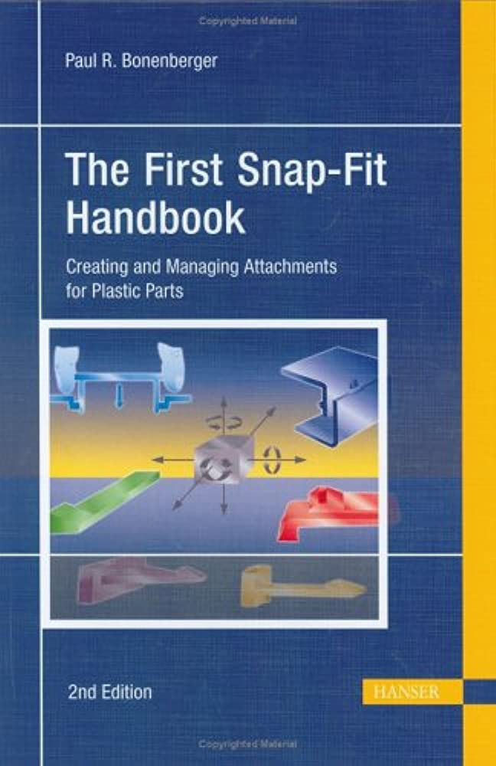
Notes:
Don't have a copy because it's 150 bucks

Slide 96
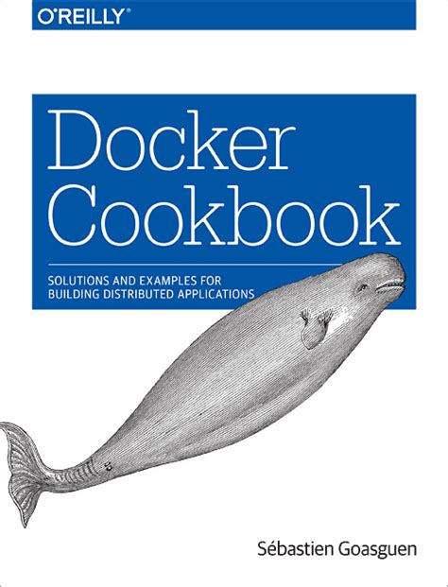
Tag Systems
API Versioning
User Profiles
Subscriptions
etc

Slide 97
What we can teach

Slide 98

Notes:
Open community
Types of Conferences
Information
Number of Software Engineers

Slide 99


Version Control

Slide 100
In Conclusion
We're engineers
We're not special
There's a lot we can teach and learn

Slide 101
Learn more!
https://www.hillelwayne.com/tags/crossover-project/ (All new examples!)
https://www.hillelwayne.com/talks/crossover-project/ (Not up yet)
Notes:
Unfortunately, I cannot provide transcripts

Slide 102
This was really easy!

Slide 103
Things I didn't ask about
Actual techniques (tagout/lockout)
Meetings
Certification Process
Software → Trad Crossovers
Engineering in the Global South
Nuclear Engineering

