Slide 1
Microservice Message Routing on Kubernetes
Frans van Buul
AxonIQ

Slide 2
Introductions
About me
About this presentation
Evangelist at AxonIQ, the new company around Axon Framework.
Prior roles
  Presales architect for Hewlett Packard / Fortify
  Java developer at Trifork and others
  Security auditor at PwC
Looking at a tiny monolithic sample Java application.
Splitting that up and deploying it as microservices on Kubernetes.

Slide 3
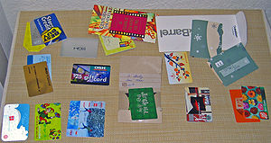
Sample domain: Gift Cards
Gift cards get issued at a certain initial value.
Each time they are used to buy something ("redeemed") the remaining value is adjusted.
Source: https://en.wikipedia.org/wiki/Gift_card

Slide 4
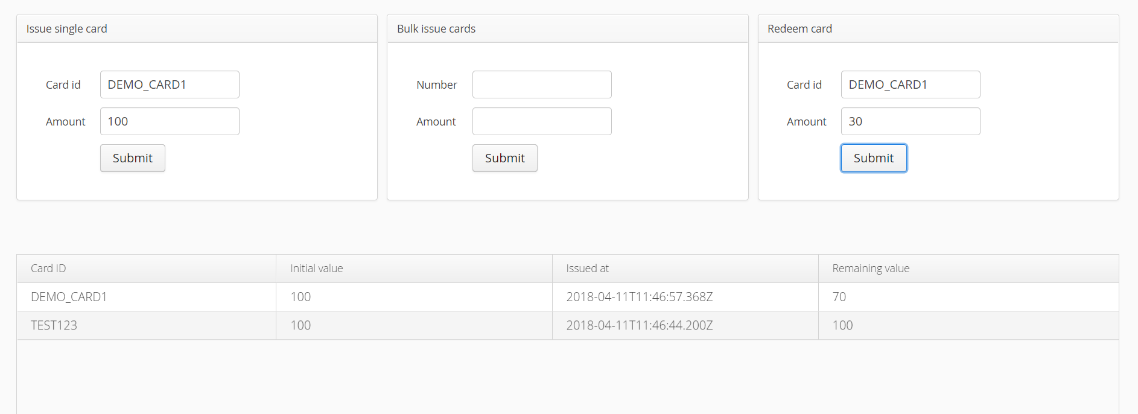
https://github.com/AxonIQ/giftcard-demo-series

Slide 5
Monolith
GiftCard system
Data store
Browser

Slide 6
Monolith
GiftCard system
Data store
Browser
How to transform our monolith into a scalable, agile microservices system running on Kubernetes?
1. How to break it up?
2. Requirements for messaging between the components?
3. Practical implementation
with Axon Framework, AxonHub, Spring Boot, Docker, Kubernetes, Google Cloud Platform

Slide 7
How to break it up?
Monolith
GiftCard system
Data store
Browser

Slide 8
GUI
Business Logic
Data store
Browser
This is still a very broad functionality (as the system grows). Not micro.

Slide 9
CRUD-type operations, probably over JSON/HTTP
Native SQL or NoSQL database commands
GUI
Business Logic
Data
Access
Data store
Browser
This doesn't offer clear advantages.
It has very clear disadvantages.

Slide 10
GUI
Business Logic
Data store
Browser

Slide 11
Issue
GUI
Data store
Browser
Redeem
Report
Actual agility and scalability will be limited by having the single data store.

Slide 12
Let's look at 2 pretty old ideas
… that are really useful in this context.

Slide 13
Command-Query Responsibility Segregation (CQRS)
Idea
Advantages
Use separate datastores for processing commands (changing state) vs. queries (providing info).
Query databases are often kept eventually consistent.
Query logic stays simple, because the query model fits the query need → maintainability and performance
Query model can use optimal technology for the job.
Query side is easily scalable, with few worries about consistency.
No workload from queries on command handling side.

Slide 14
Domain-Driven Design (DDD) and Aggregates
Idea
Advantages
Designing software in such a way that (part of) it closely aligns with a domain model.
One specific building block: Aggregate: "A cluster of associated objects that are treated as a unit for the purpose of data changes."
Aggregates are consistency boundaries.
Design the command side in terms of aggregates.
Broadly: having your microservices align with a domain model helps make them independently evolvable.
Aggregates help size command-side microservices:
  2 aggregates should never "have to be" in the same service
  1 aggregate should not be "spread across" multiple services
Source: Eric Evans, Domain-Driven Design

Slide 15
GUI
Business Logic
Data store
Browser

Slide 16
GiftCard Aggregate
Data store
Commands
GUI
Browser
Events
GiftCard Report
Data store
Queries

Slide 17
Of course we want to scale this out now!
GiftCard Aggregate
Data store
Commands
GUI
Browser
Events
GiftCard Report
Data store
Queries
How to set up actual exchange of messages?

Slide 18
Message requirements
Generic requirements to make this work at scale:
Fast, efficient, asynchronous
Some form of load balancing
Dynamic scaling of nodes
There are also a number of specific requirements for the 3 message stereotypes command, event and query!

Slide 19
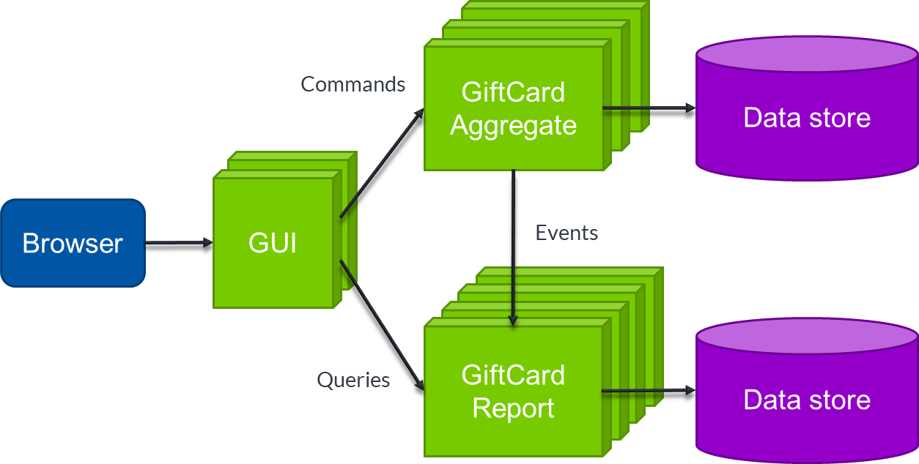
Command messages
Route to a single handler instance (load balancing)
Use consistent routing based on aggregate id
Associated response required by client (success/failure).

Slide 20
GiftCard Aggregate
Data store
Commands
GUI
Browser
Events
GiftCard Overview Report
Data store
Queries
GiftCard Detail Report
Data store

Slide 21
Event messages
In this case, each event should lead to 1 update on data store (competing consumer).

Slide 22
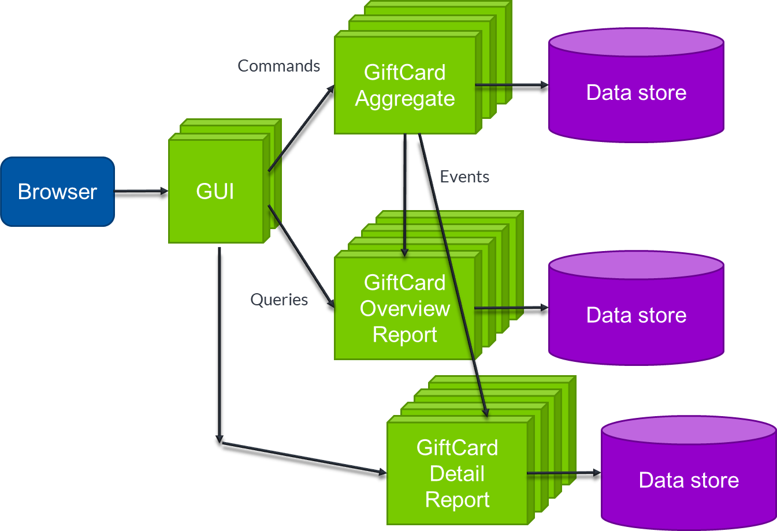
Event messages
The general rule: handled once by every logical event handler.

Slide 23
Event messages
The general rule: handled once by every logical event handler.
Parallel processing is desirable, but should follow a sequencing policy.
3
1
2
3
4
1
2
Event stream
4
"3" may get processed before "2"
If "2" is "Create Card X" and "3" is "Redeem Card X" this may fail

Slide 24
Event messages
The general rule: handled once by every logical event handler.
Parallel processing is desirable, but should follow a sequencing policy.
Event replay is a very convenient feature to initialize new read models.
What if this is introduced while the system is already in use?

Slide 25
Query messages
Route to a single handler instance (load balancing)
Associated response required by client.
More advanced query patterns could also occur (scatter-gather).

Slide 26
Message requirements
Generic
Stereotype-specific
Fast, efficient, asynchronous
Some form of load balancing
Dynamic scaling of nodes
Commands: single execution consistent routing, responses
Events: processed once per logical handler, sequencing policy, no responses, replay
Queries: load balancing, responses, usually (not always) executed once.

Slide 27

Monolith
GiftCard system
Data store
Browser
How to transform our monolith into a scalable, agile microservices system running on Kubernetes?
1. How to break it up?
2. Requirements for messaging between the components?
3. Practical implementation
with Axon Framework, AxonHub, Spring Boot, Docker, Kubernetes, Google Cloud Platform

Slide 28
Axon Framework
Open source Java Framework.
Started 7 years ago.
700k+ downloads, 50% of which in the past 6 months.
Started out as "CQRS Framework", currently used a lot for microservices.
Key principle: location transparency

Slide 29
Location transparency in Axon
Commands as illustration – Queries and Events work similarly
Application's @CommandHandler
methods (GiftCard Aggregate)
Code that needs to execute a commands (GiftCard GUI)
send to
send to
register to
<<interface>>
CommandBus
implements
implements
implements
<<class>>
SimpleCommandBus
<<class>>
AsyncCommandBus
<<class>>
DistributedCommandBus

Slide 30
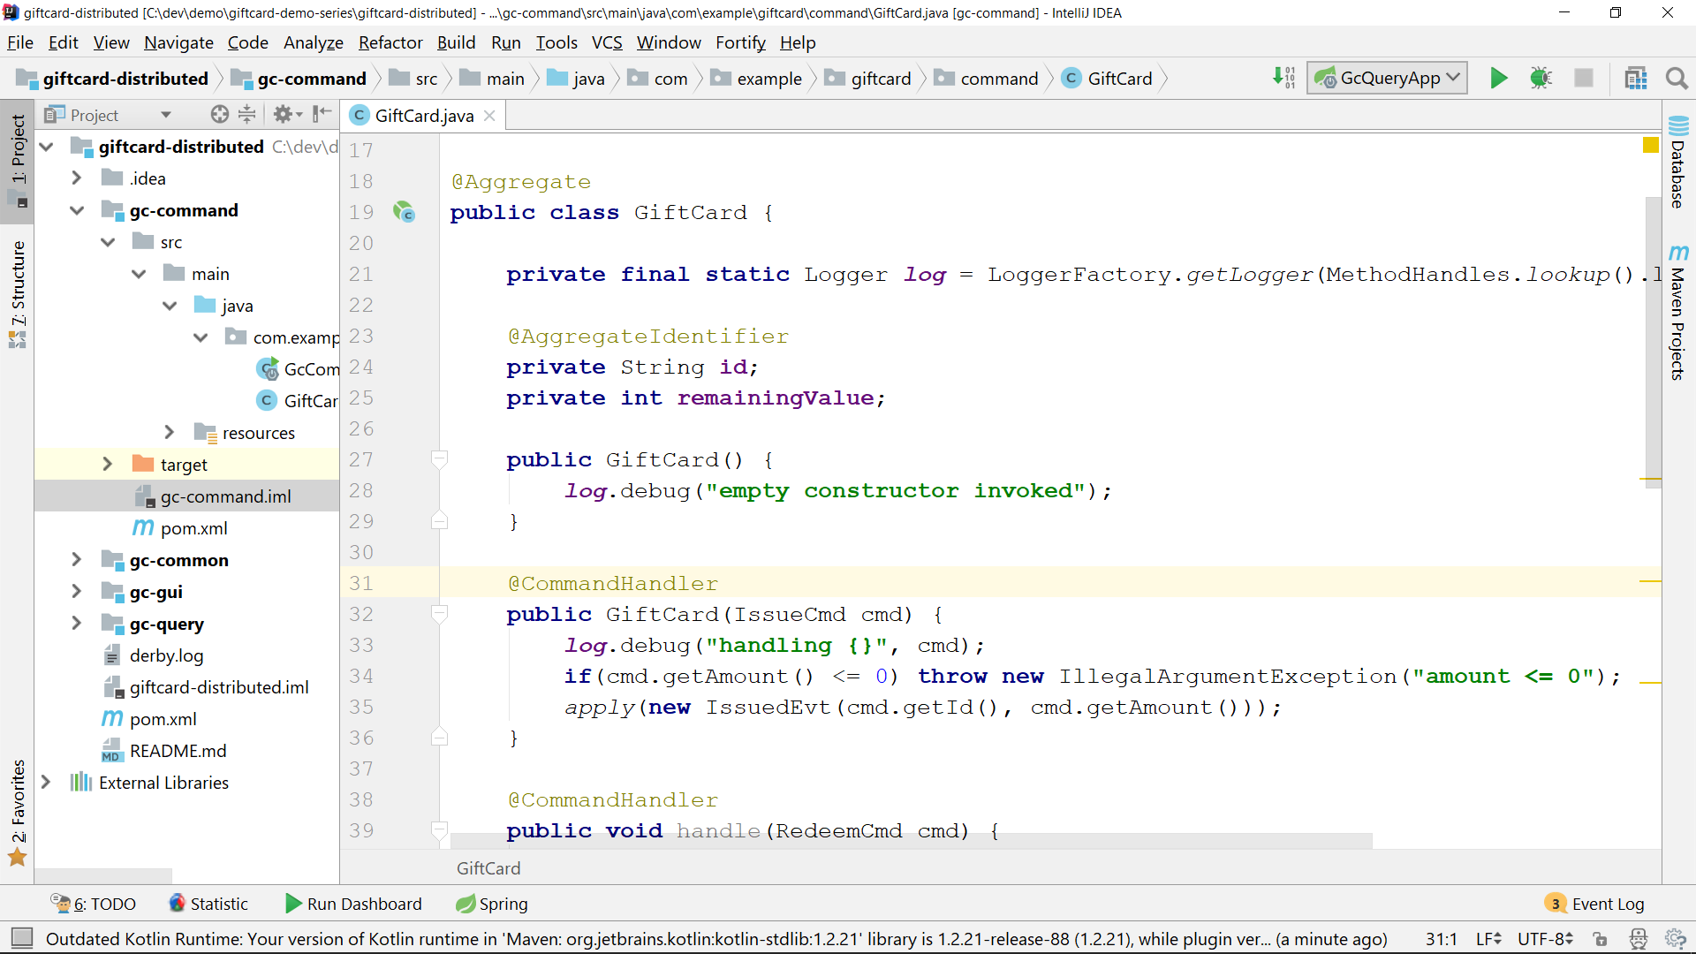
Notes:
aggregate with command and event handlers. There's nothing here which makes this aggregate available as a microservice

Slide 31
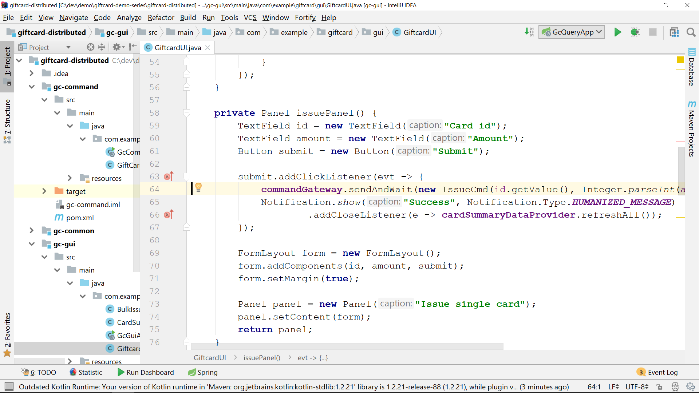

Slide 32
Practical distribution with Axon
Until recently
Commands
Events
Queries
SpringCloud + HTTP
or
JGroups
Either AMQP
or
tracking a database table
No standard functionality; typically custom REST interface with HTTP load balancing.
Complex to set up correctly.
Doesn't meet all requirements.

Slide 33
Practical distribution with Axon
Commands
Events
Queries
SpringCloud + HTTP
or
JGroups
Either AMQP
or
tracking a database table
No standard functionality; typically custom REST interface with HTTP load balancing
or
AxonHubCommandBus
or
AxonHubEventBus
or
AxonHubQueryBus

Slide 34
AxonHub essentials
It's a server system, distributed as a .jar, together with an open source AxonHub client.
Unified, asynchronous messaging system for Commands, Events and Queries.
Has the intelligence to do correct routing with near-zero configuration, using specific Command, Event and Query routing patterns.

Slide 35
How does it work?
When an application has an AxonHub*Bus, two things happen:
  When that application puts a message on the bus, it will be sent to AxonHub for further processing.
  The application will actively inform AxonHub about the @CommandHandlers, @QueryHandlers and @EventHandlers it has.
In combination with
AxonHub's understanding of message meta-data and routing patterns,
2-way gRPC connections
this allows fully automatic routing and monitoring / management functionality.

Slide 36
AxonHub and AxonDB
Events go through AxonHub doesn't store events itself – it needs an event store for that.
AxonDB is AxonIQ built-for-purpose event store.
Axon
Hub
Axon
DB

Slide 37
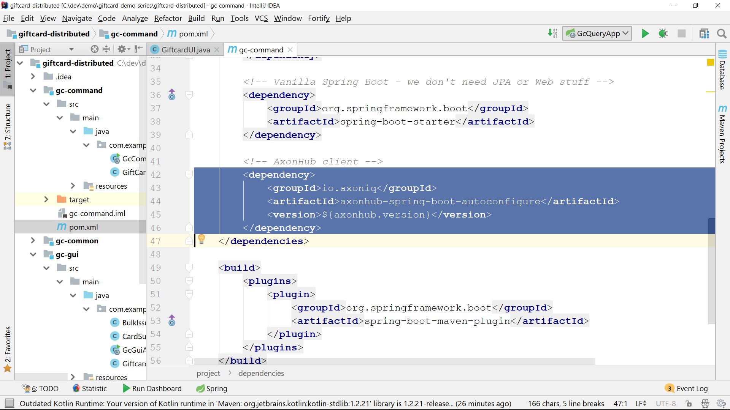

Slide 38
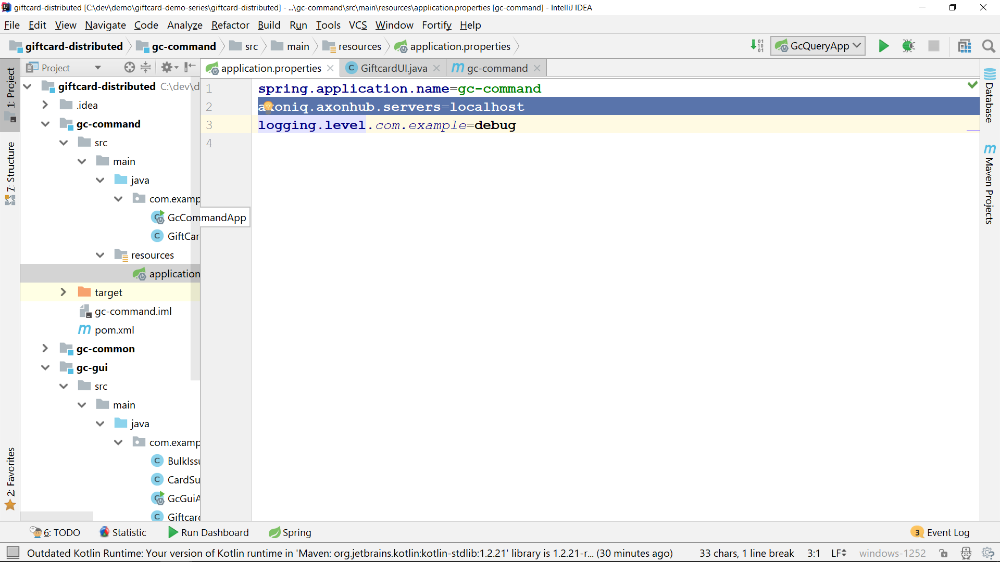

Slide 39
Kubernetes deployment
gc-command
gc-query
gc-gui
All 3 are standard Kubernetes "deployments" of a Pod with a single Docker container. Pods are ephemeral.
Each need to operate as a cluster for HA
Won't work as a "deployments"
Instead, using "StatefulSet".
Pods get identity (network, storage)
Scaled up and down sequentially
axonhub
axondb

Slide 40
Deploying gc-command
Dockerfile
FROM openjdk:8-jdk-alpine
VOLUME /tmp
ADD gc-command-1.0.jar app.jar
ADD application.properties .
ENTRYPOINT ["java","-jar","/app.jar"]
application.properties
axoniq.axonhub.servers=axonhub.default.svc.cluster.local
When creating the Kubernetes StatefulSet, this DNS SRV entry will be created and point to all nodes of the cluster.

Slide 41
Deploying gc-command
Pushing this to Google Kubernetes Engine via Google Container Repository:
docker build -t gc-command .
docker tag gc-command eu.gcr.io/giftcard-distributed/gc-command
docker push eu.gcr.io/giftcard-distributed/gc-command
kubectl run gc-command --image eu.gcr.io/giftcard-distributed/gc-command --replicas=1

Slide 42
axonhub.yaml
apiVersion: apps/v1
kind: StatefulSet
metadata:
name: axonhub
spec:
serviceName: "axonhub"
replicas: 3
selector:
matchLabels:
app: axonhub
template:
metadata:
labels:
app: axonhub
spec:
containers:
- name: axonhub
image: eu.gcr.io…
ports:
- containerPort: 8124
protocol: TCP
name: grpc
- containerPort: 8024
protocol: TCP
name: gui
readinessProbe:
…
apiVersion: v1
kind: Service
metadata:
name: axonhub
labels:
app: axonhub
spec:
ports:
- port: 8124
name: grpc
targetPort: 8124
clusterIP: None
selector:
app: axonhub
---
apiVersion: v1
kind: Service
metadata:
name: axonhub-gui
labels:
app: axonhub
spec:
ports:
- port: 8024
name: gui
targetPort: 8024
selector:
app: axonhub
type: LoadBalancer
---
AxonHub gRPC port: headless service, all instances registered in DNS by Kubernetes
AxonHub management GUI: behind HTTP load balancer

Slide 43
Switching to live demo now
(but there are some slides after this one as backup)

Slide 44
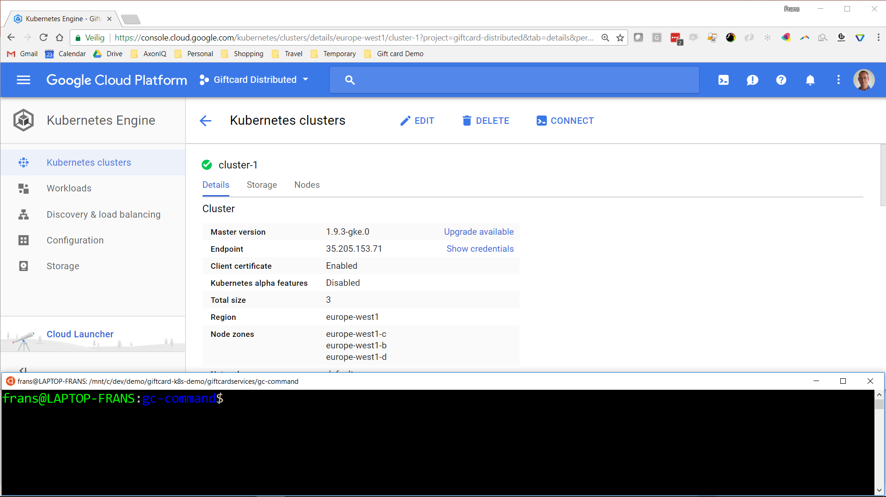
Notes:
Running a 3-node Kubernetes cluster on Google Cloud Platform. This is a regional cluster, spread across three zones. Physically this is in Belgium.

Slide 45
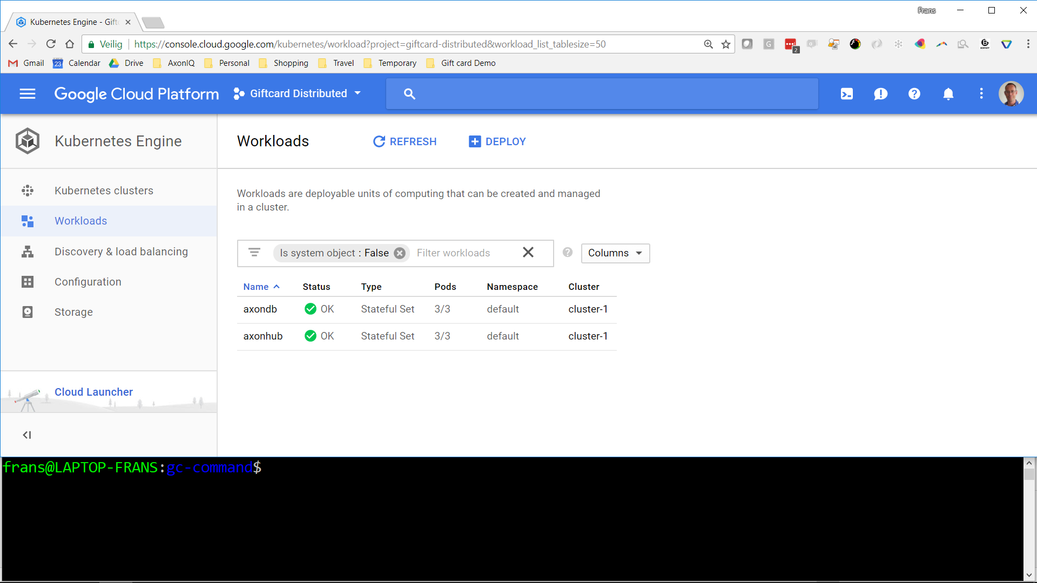
Notes:
Running 3-node AxonDB and AxonHub clusters on top of the Kubernetes cluster. Application hasn't been deployed yet.

Slide 46
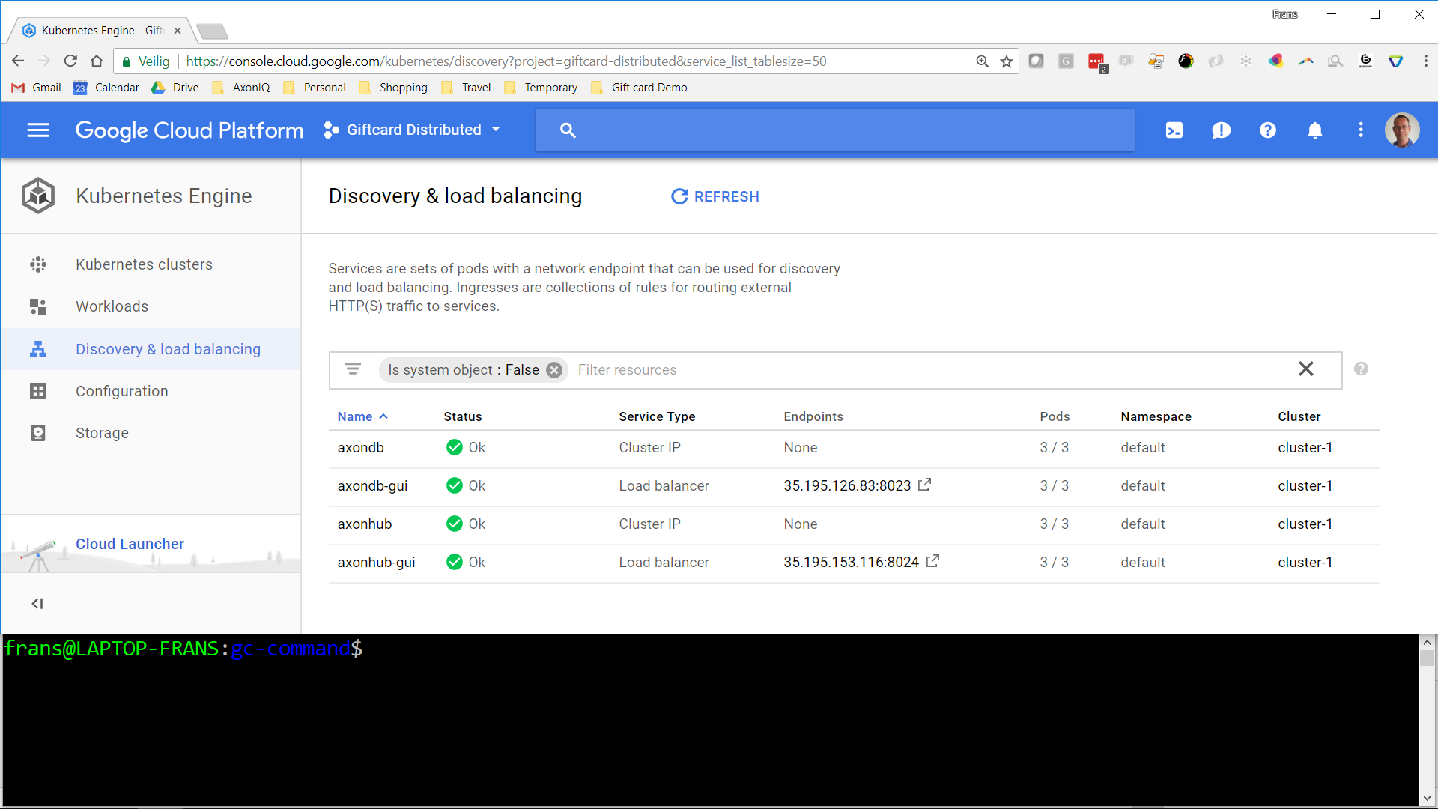
Notes:
We can access the Hub (and DB) GUI through a load balancer managed by Kubernetes

Slide 47
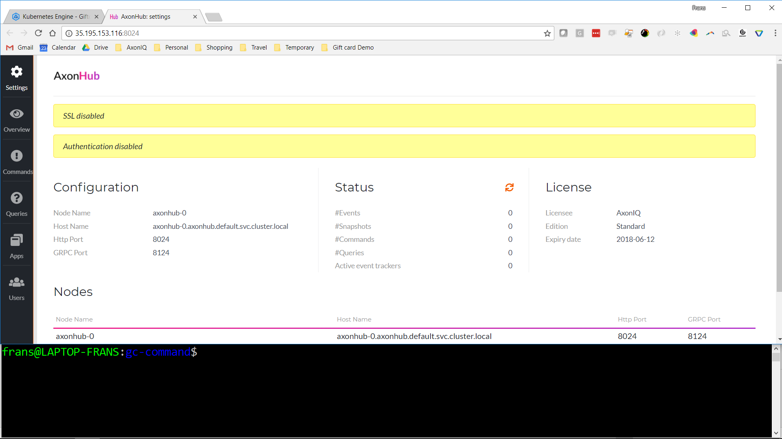
Notes:
AxonHub GUI – everything empty

Slide 48
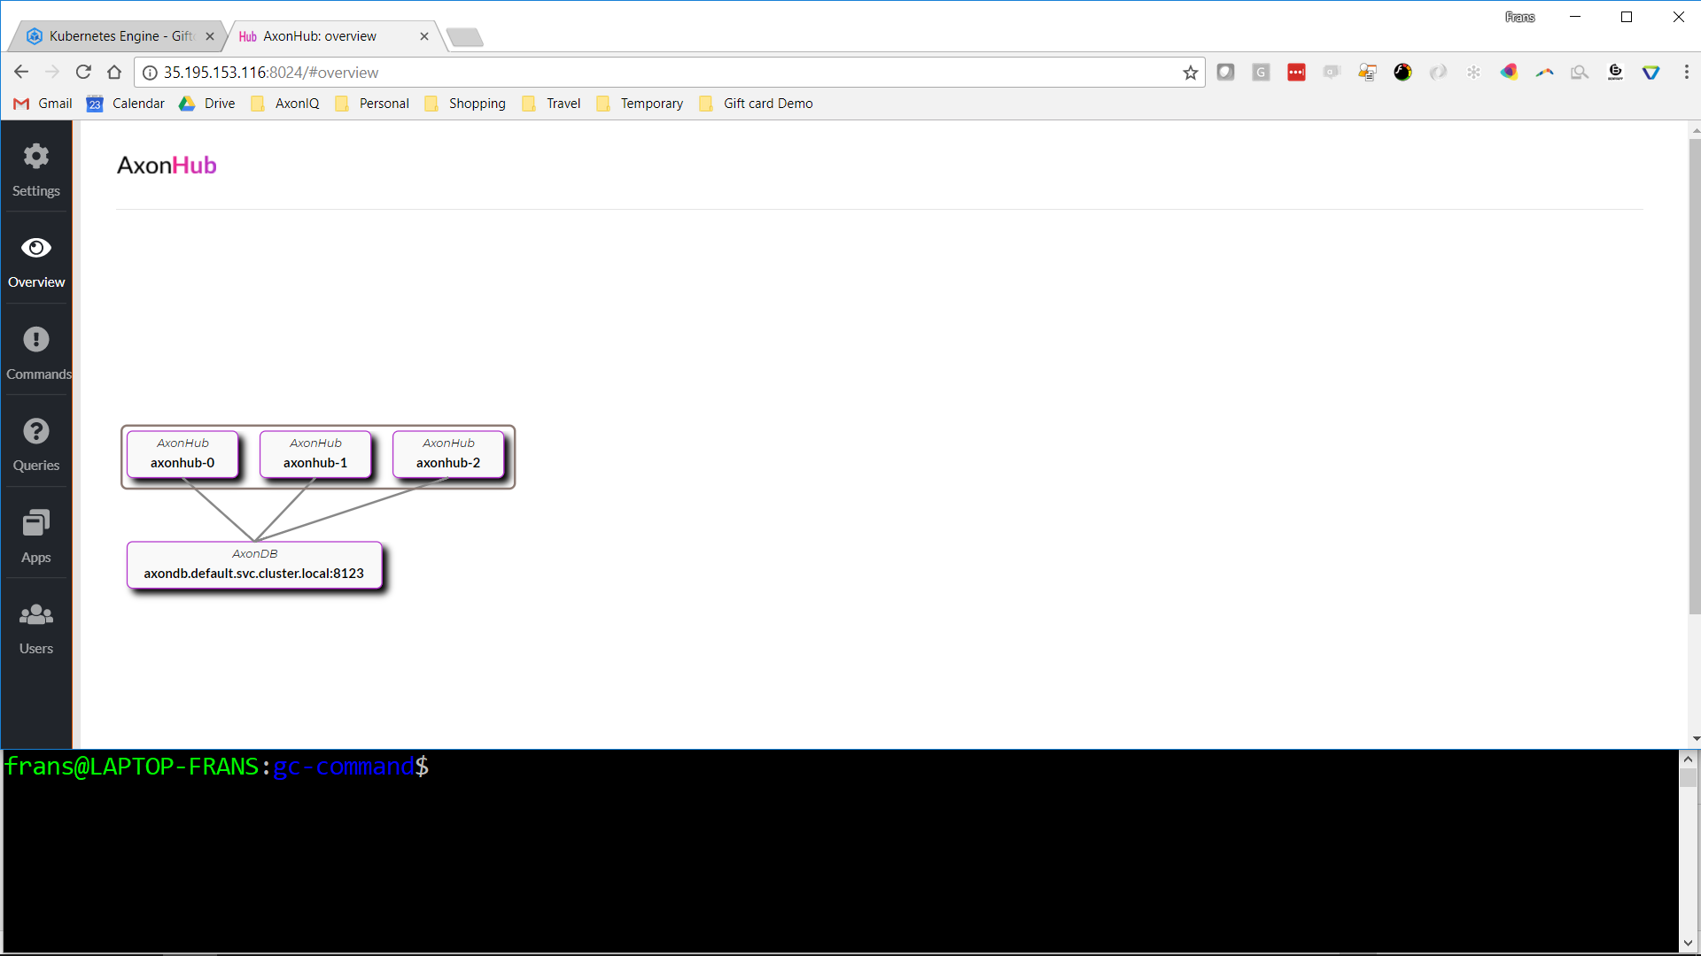
Notes:
AxonHub architecture overview. Shows the 3-node Hub cluster, and the connection with the DB cluster. No applications yet.

Slide 49
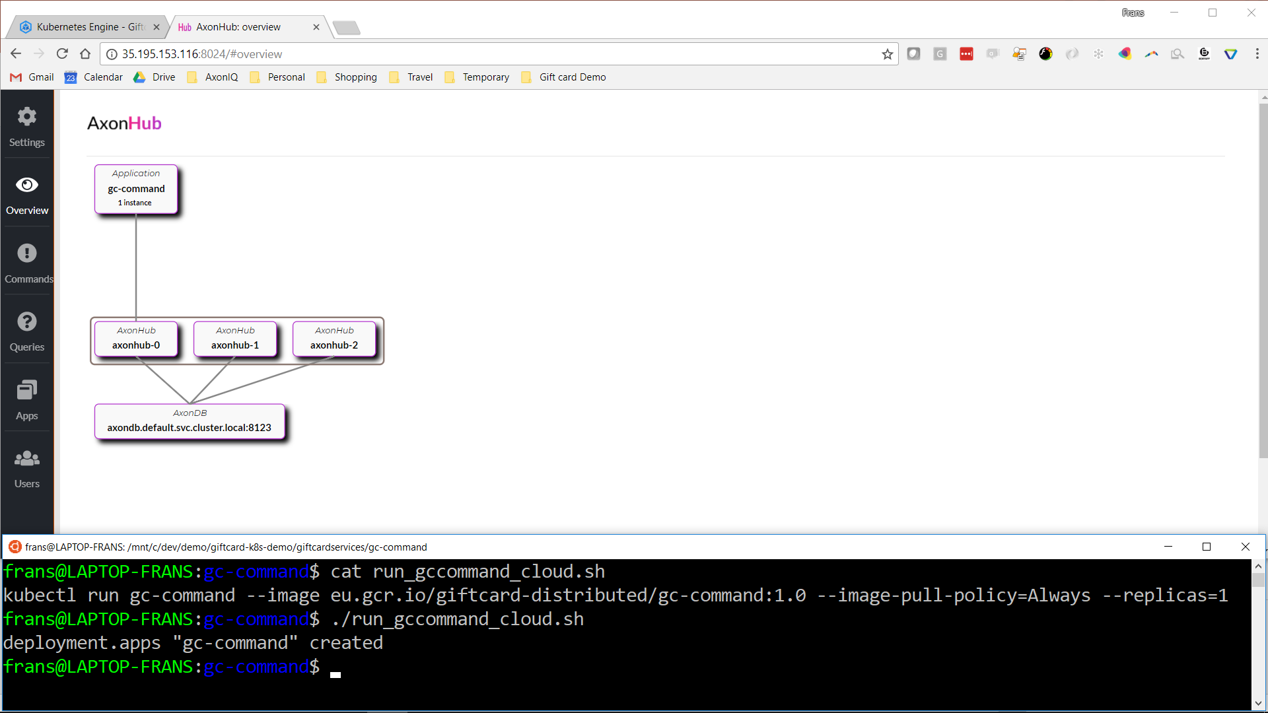
Notes:
After deploying the gc-command workload, we see it appear in the architecture overview page of the AxonHub GUI

Slide 50
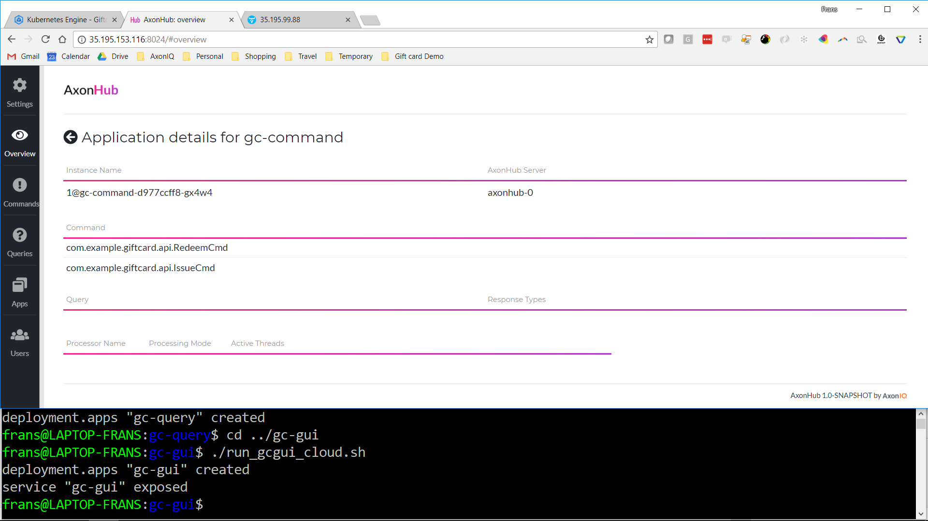
Notes:
Detailed tech info available by clicking on components in the architecture overview

Slide 51
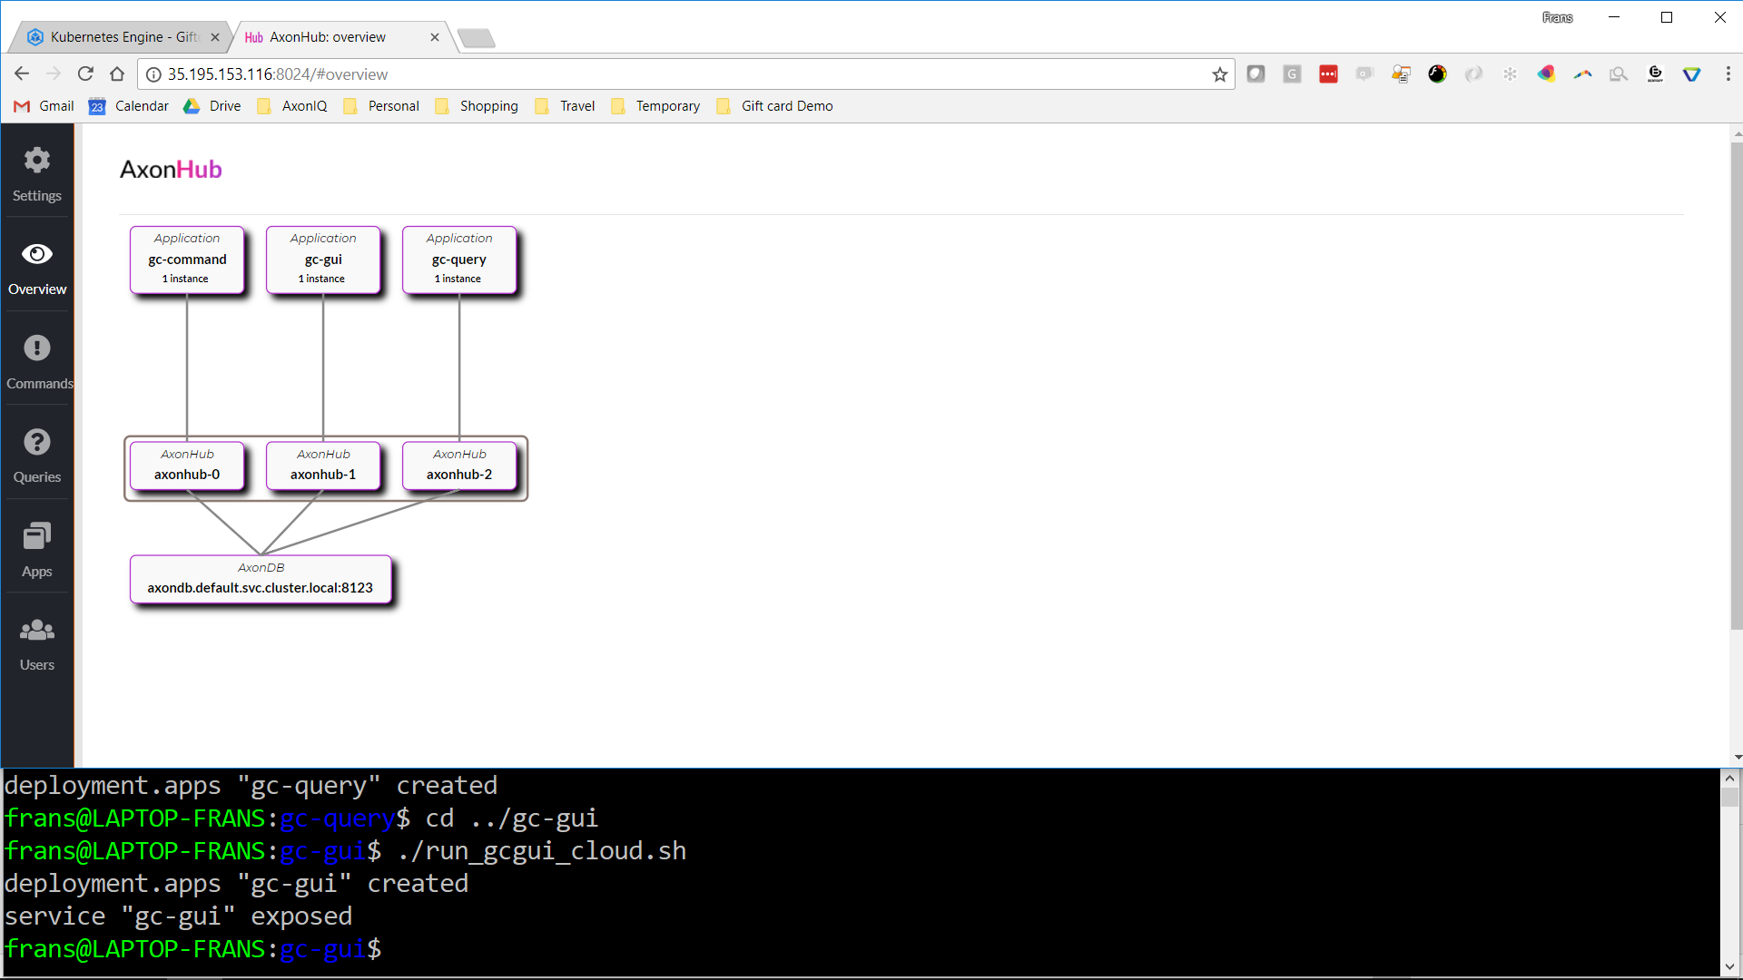
Notes:
The same goes for gc-gui and gc-query.

Slide 52
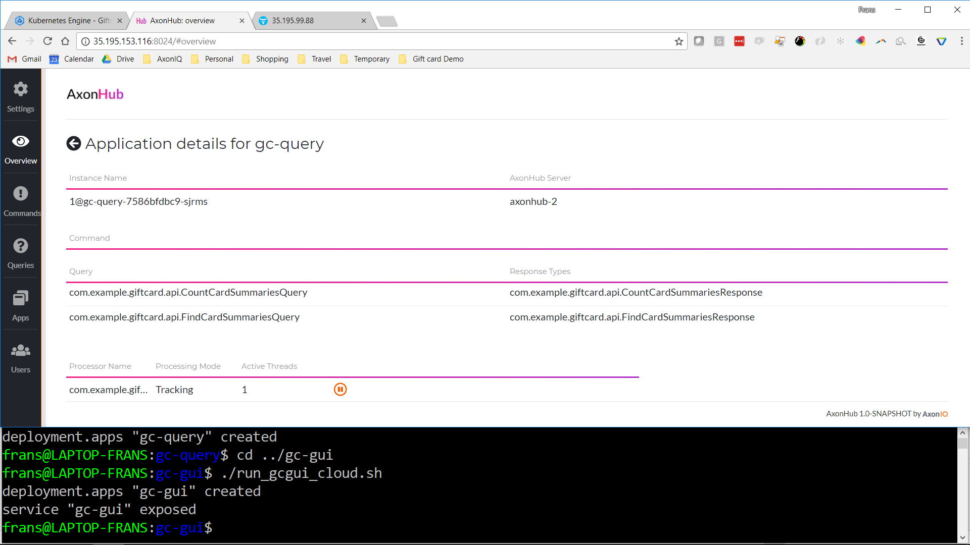

Slide 53
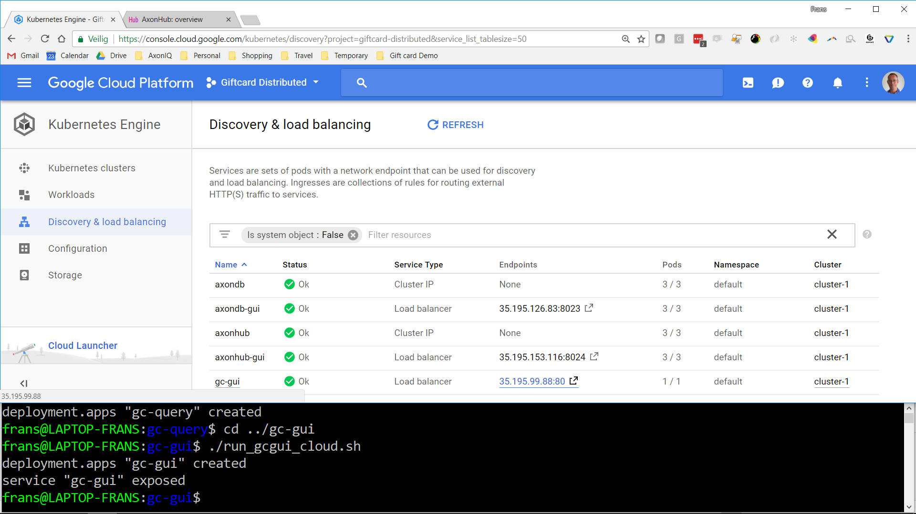
Notes:
There's now a new Kubernetes load balancer for gc-gui where we can test our app

Slide 54
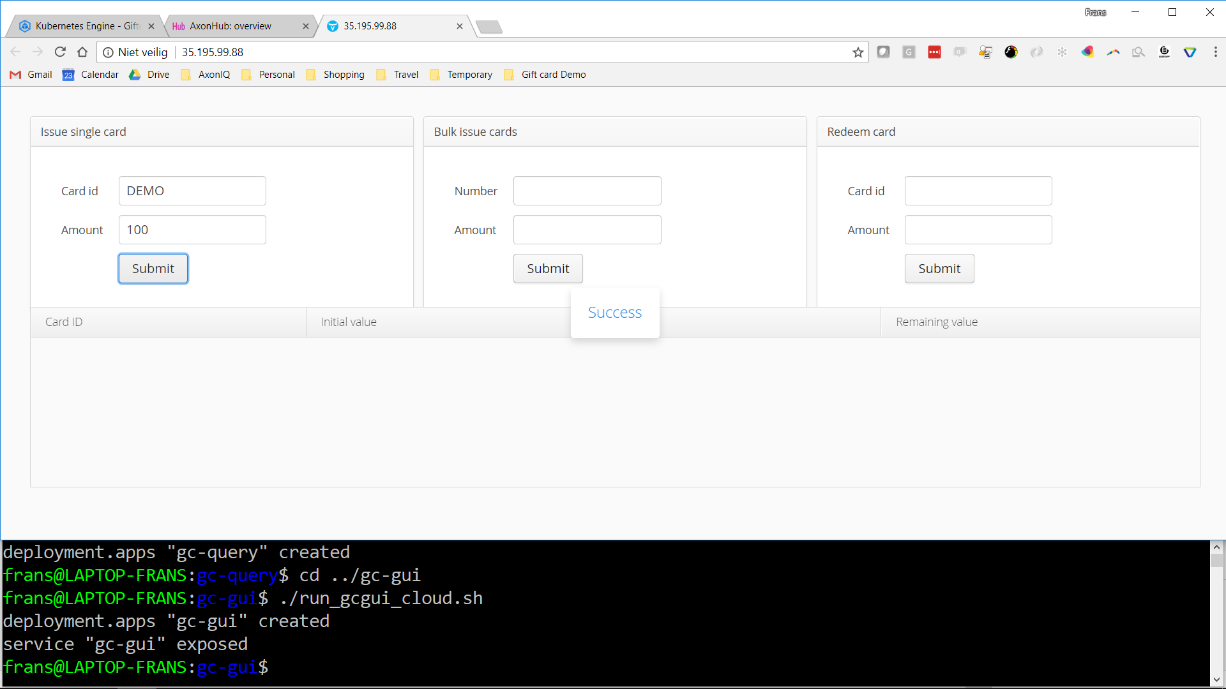
Notes:
Issueing card 'DEMO' for 100

Slide 55
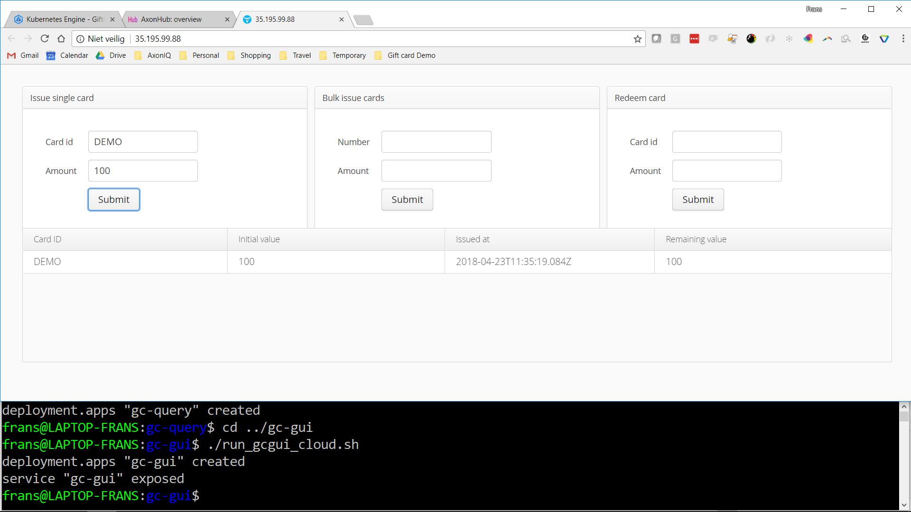

Slide 56
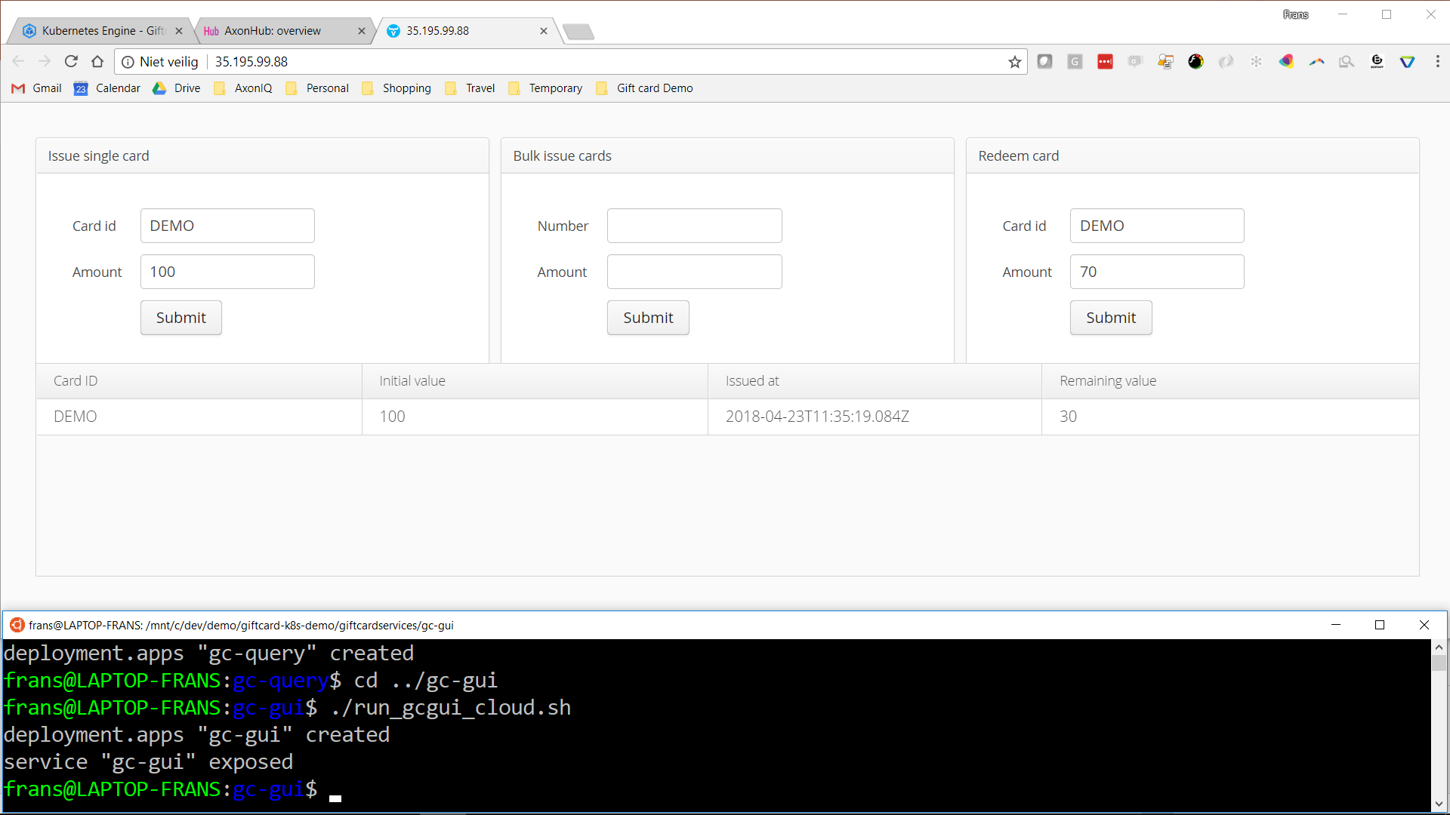
Notes:
After redeeming 70

Slide 57
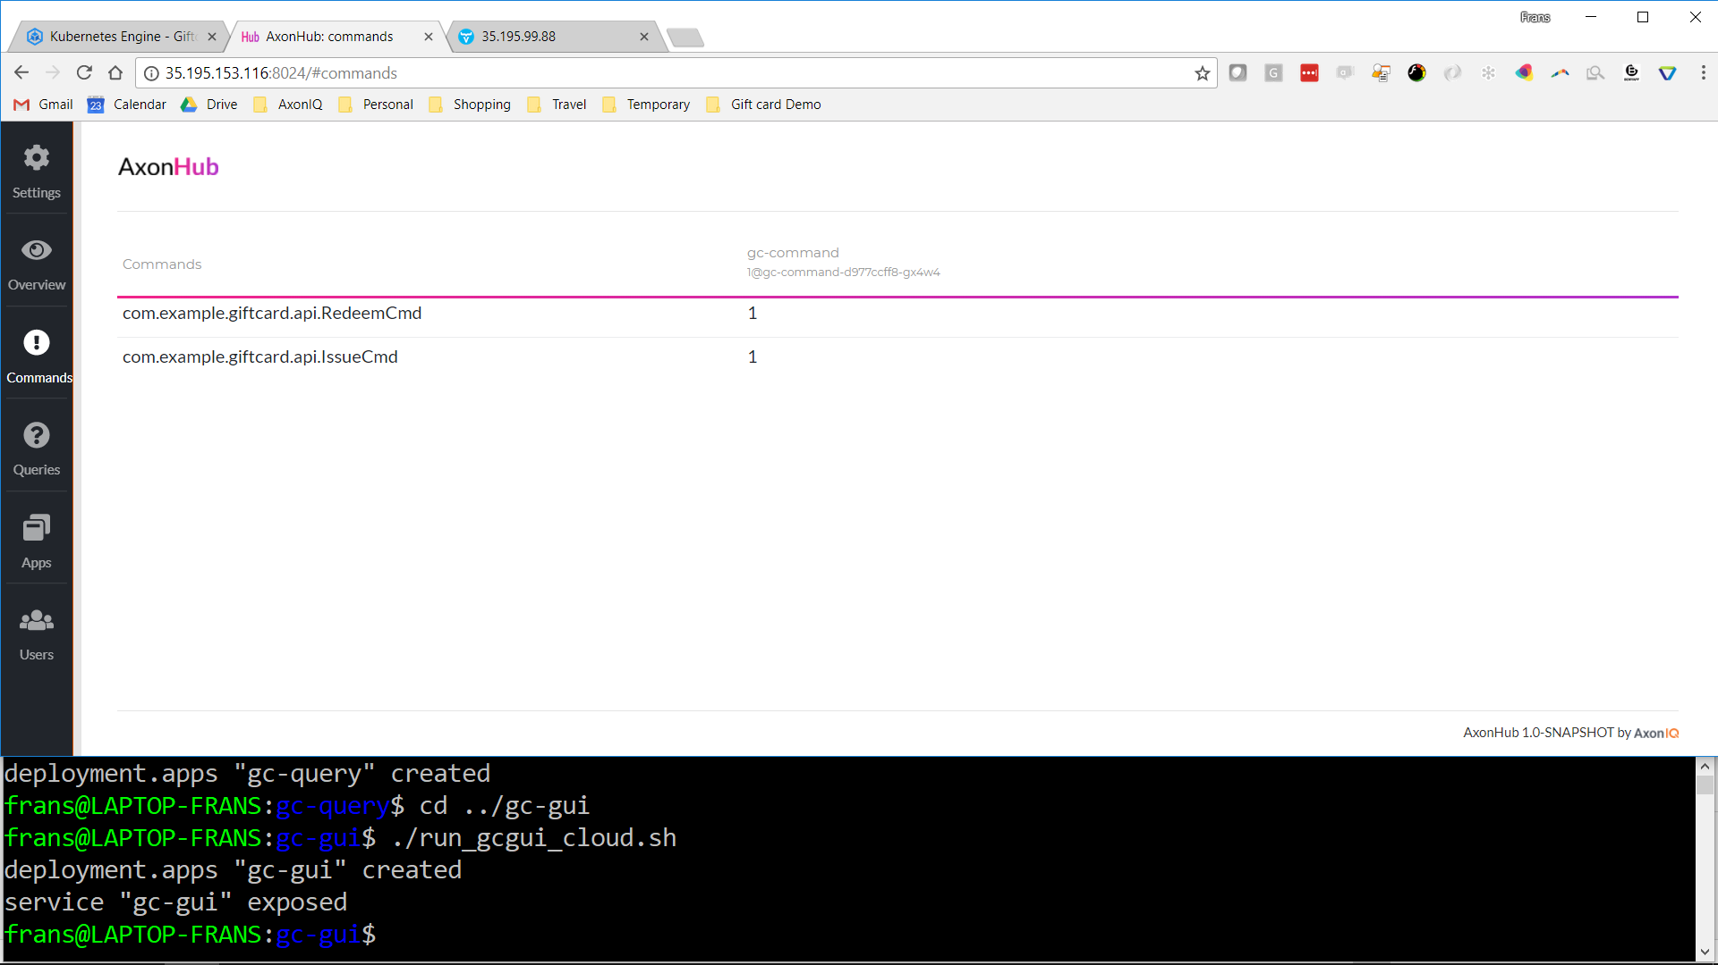
Notes:
Counters show the issue and redeem command

Slide 58
Scaling out
Demo

Slide 59
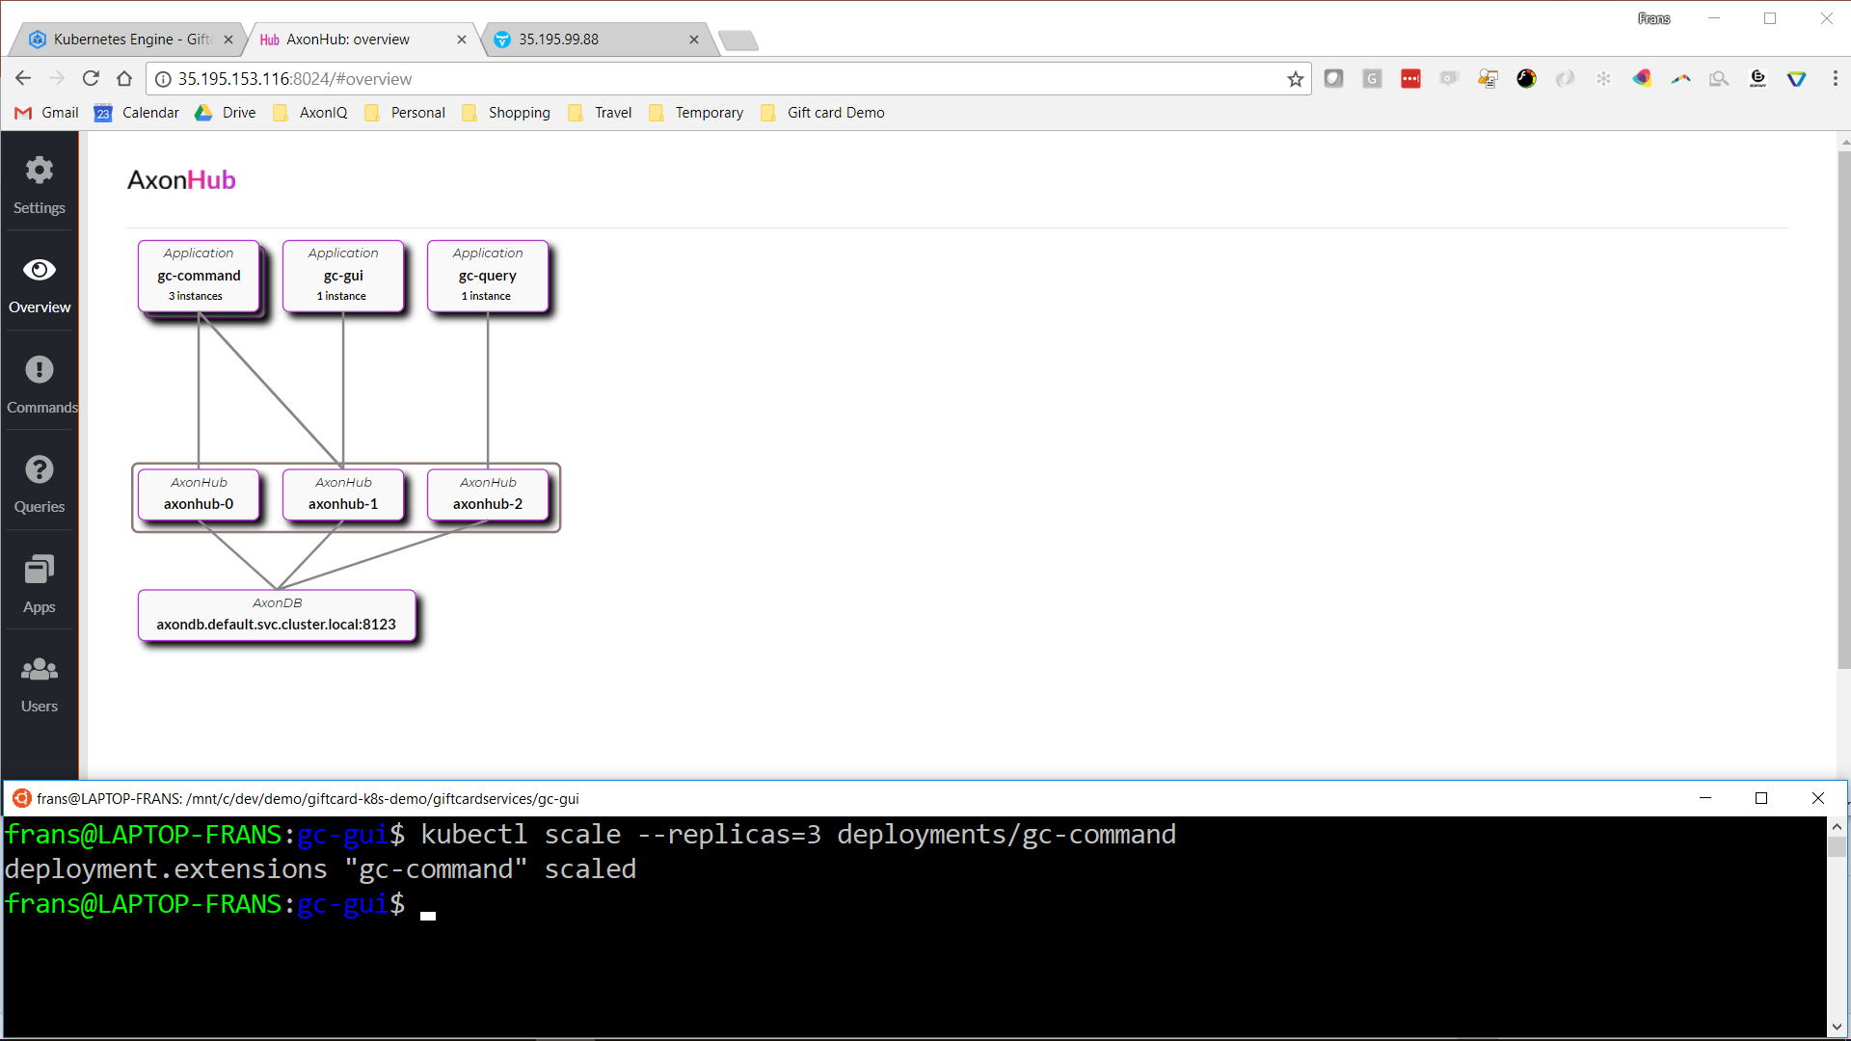
Notes:
Scaling out the command handlers from 1 to 3 instances using Kubernetes. AxonHub will automatically detect them

Slide 60
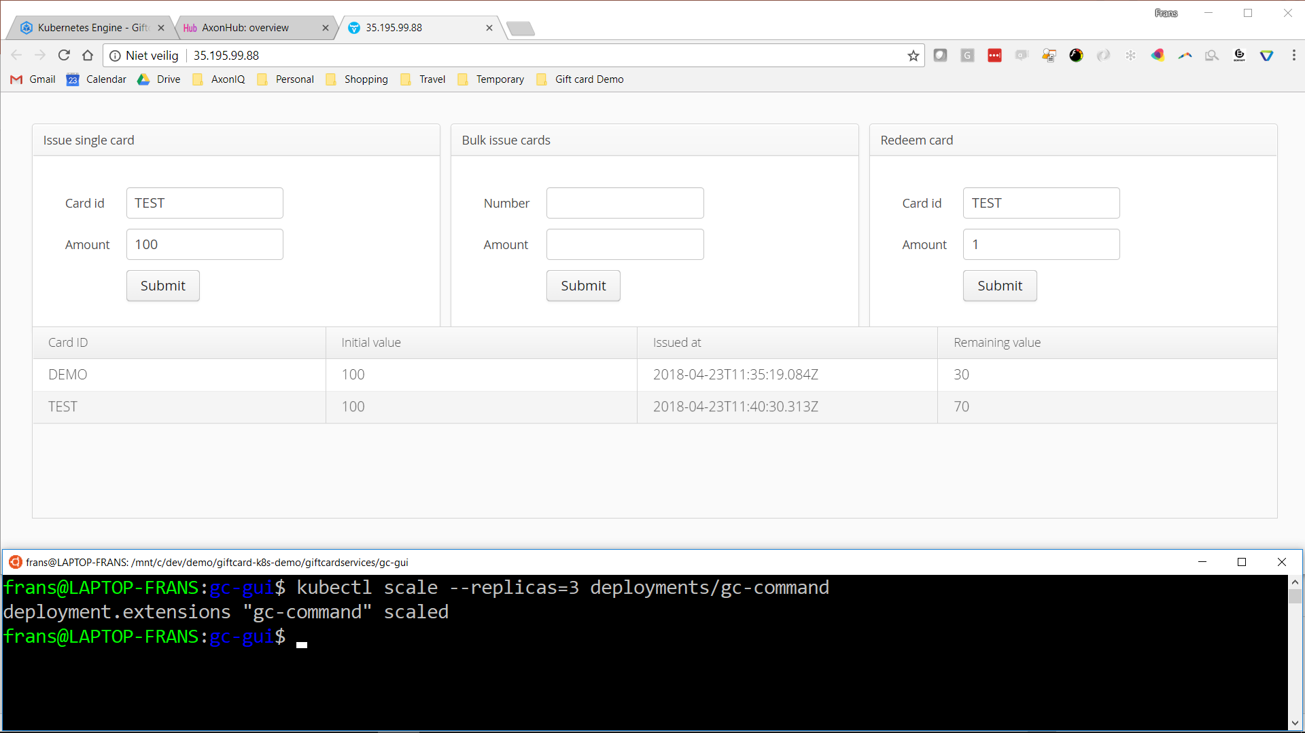
Notes:
Issuing a new card called 'TEST' of value 100 and performing 30 redeems of 1 – remaining value 30. Total 31 commands.

Slide 61
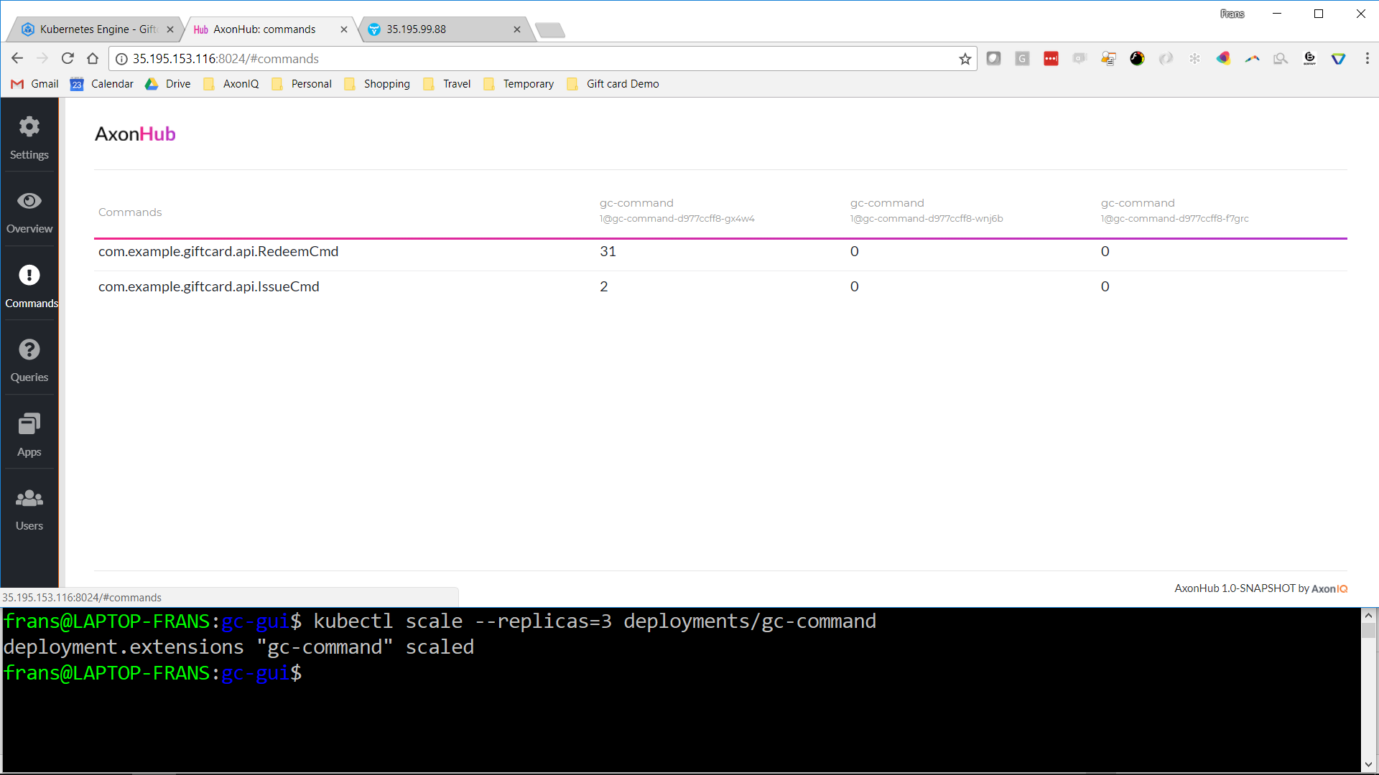
Notes:
Consistent hashing in action: they all went to the same command handler (which is also the same handler that was processing the commands to our earlier DEMO card, but that's just a coincidence)

Slide 62
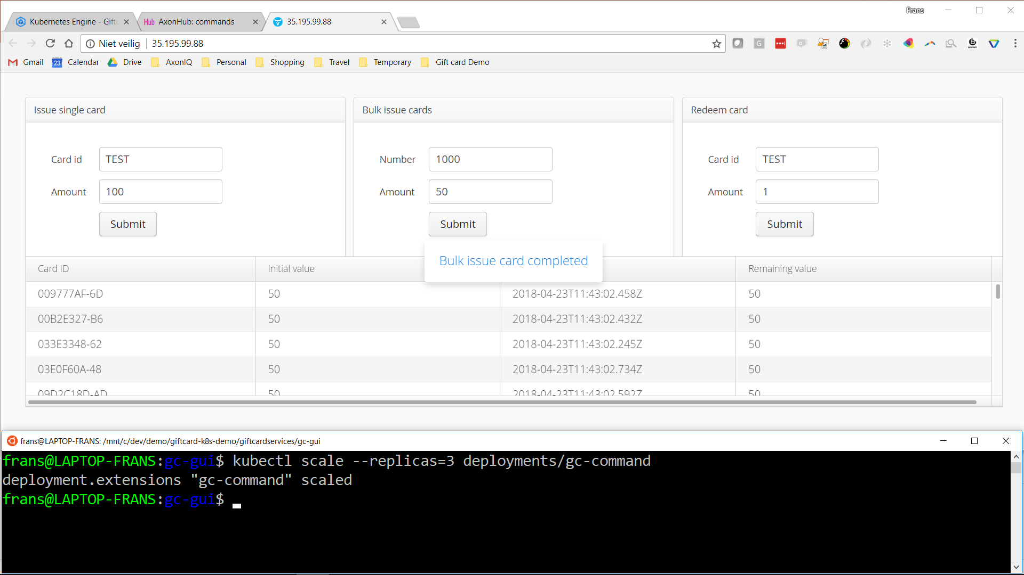
Notes:
Bulk-issuing 1000 cards of value 50, with random names.

Slide 63
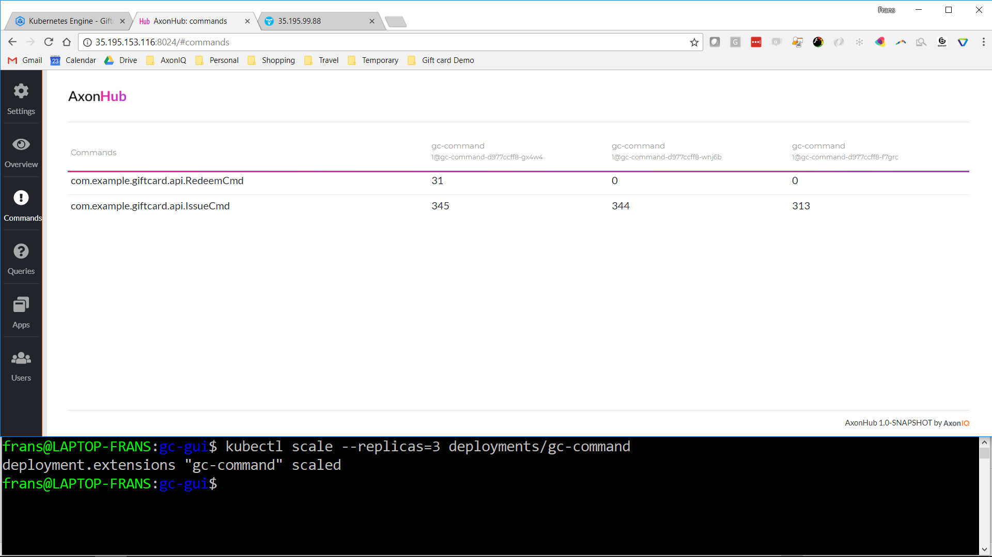
Notes:
Commands our now spread across the 3 command handler instances.

